Slide 1

Who Does the Algorithm Save: Preserving Humanity with AI in Healthcare
All Things AI 2026-Keynote
Case Studies in Healthcare AI and What They Mean for and the Evolving Landscape
Yassah Reed
Technical Support Engineer
Notes:
Someo in a doctors office

Slide 2
Objectives
NarxCare vs TREWS
Why you should care about AI in Healthcare?
Impact of AI in Healthcare
What you can do?
Considerations for Safe AI Implementation

Slide 3
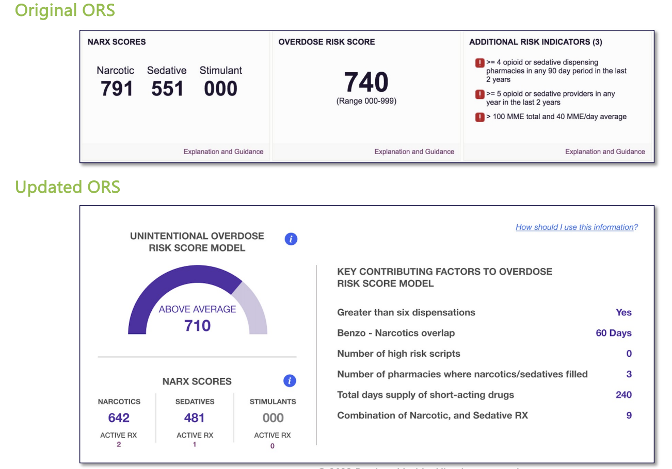
NarxCare
Bamboo Health
A machine learning-powered platform that aggregates controlled substance prescription data the PDMP to provide clinicians with visualizations and analytics. Its primary output, the NarxScore, is a quantitative risk score ranging from 000-999 designed to help prescribers and dispensers assess a patient's likelihood of medication misuse, abuse, or overdose.
Prescription Drug Monitoring Program(PDMP): electronic database that tracks controlled substance prescriptions in a state originally created for .

Slide 4

NarxScore Impact
Score Bias Towards:
Individuals that have complex, chronic disease
Women
Individuals who go to teaching hospital
A third of patients are misclassified
False-positive rate of 17.2%
False-negative rate of 13.4%
“I’ve got red warnings coming at me, which makes me feel like the medical board may be after me if I do anything to control his pain.”
-Anonymous ER Doctor
Notes:
Alarm

Slide 5

TREWS
Bayesian Health
Stands for Targeted Real-time Early Warning System is a machine learning algorithm developed at Johns Hopkins that continuously monitors EHR data including vitals, labs, and clinical notes to detect early physiological signs of sepsis and alert clinicians to intervene before the condition becomes life-threatening.
EHR/EMR: Electronic Health Record
Sepsis: a life-threatening emergency where the body's response to infection turns against itself, rapidly shutting down organs and killing nearly 270,000 Americans annually. Every hour without treatment increases the risk of death, making early detection not just clinically important but the difference between life and loss.
Notes:
Trew Johns Hopkin

Slide 6
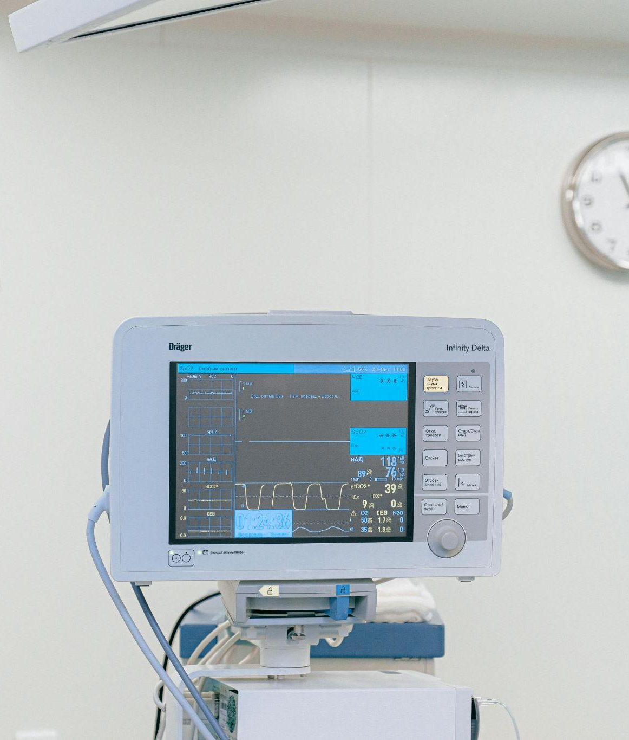
TREWS Impact
Sepsis is leading cause of hospital death with a mortality rate of approximately 12.5% to 30%
Reduced sepsis mortality rates by 18% in dozens of hospitals across the United States
“...Achieved a 90% adoption rate by seamlessly integrating into clinicians’ workflows, leveraging comprehensive medical record data”
  Adoption for similar technology typically hovers between 6-45%
TREWS identified more than 80% of sepsis cases before clinical onset, helping clinicians recognize and respond to the condition an average of three hours earlier.
Notes:
Sepsis

Slide 7
What can we learn from these AI Implementations?
Takeaways
Is this a decision AI should be making?
Is the right data being used? Are we checking data for bias?
Do the humans involved understand AI and how these conclusions are subject to error?
Were the end users trained on the system correctly?
Do we understand the impact of this AI system?

Slide 8
Let’s Compare
Narx
TREWS
Basis
Predicts Future Behavior
Analyzes Physiological Signals
Data Collected for Law Enforcement Use
Data
Historical Patient Medical Records
Training
Minimal
Personalized Deployment
Transparency
Proprietary Algorithm
Proprietary Algorithm**
Human Role
Gatekeeper
Champion

Slide 9
Activity: Take 30 Seconds to Think
How can YOU help make AI more ethical?

Slide 10


Thank you
Follow Me On Linkedin

Slide 11
Sources
American Medical Association. (n.d.). To succeed with health care AI, get rid of the black box. Retrieved November 30, 2025, from https://www.ama-assn.org/practice-management/digital-health/succeed-health-care-ai-get-rid-black-box
Hassan, R., Nguyen, N., Finserås, S. R., Adde, L., Strümke, I., & Støen, R. (2025). Unlocking the black box: Enhancing human-AI collaboration in high-stakes healthcare scenarios through explainable AI. Technological Forecasting and Social Change. https://doi.org/10.1016/j.techfore.2025.S0040162525002963
HIPAA Times. (n.d.). What is explainable AI? Retrieved November 30, 2025, from https://hipaatimes.com/what-is-explainable-ai
Stone, E. (2024, April 14). AI in healthcare: Counteracting algorithmic bias. The Deerfield Review. Boston University. https://www.bu.edu/deerfield/2024/04/14/stone2-2/
Oliva, J. D. (2022). Dosing discrimination: Regulating PDMP risk scores. California Law Review, 110, 47. https://heinonline.org/HOL/LandingPage?handle=hein.journals/calr110&div=4&id=&page=
Siegel, Z. (2022, June). In a world of stigma and bias, can a computer algorithm really predict overdose risk? Annals of Emergency Medicine, 79(6), A16-A19. https://www.annemergmed.com/article/S0196-0644(22)00243-8/fulltext
Kabella, D., Apollonio, D., Young, H., & Knight, K. R. (2025). The rise of clinical decision support algorithms in pain management 2009–2024. Journal of General Internal Medicine. https://doi.org/10.1007/s11606-025-09600-9
Medscape. (2025). Hidden formulas: High-stakes fight to regulate clinical decision [Article]. https://www.medscape.com/viewarticle/hidden-formulas-high-stakes-fight-regulate-clinical-decision-2025a1000cw3
Medscape. (2025). When an algorithm guides pain management: Growing backlash. https://www.medscape.com/viewarticle/when-algorithm-guides-pain-management-growing-backlash-2025a100091n?form=fpf
Bamboo Health. (2023). NarxCare & the overdose risk score [PDF]. Alaska Department of Commerce, Community, and Economic Development. https://www.c"Artificial Intelligence and Human Skill Combine to Help Patients Avoid ICU." UCHealth Today, UCHealth, www.uchealth.org/today/monitoring-for-sepsis-artificial-intelligence-and-human-skill-combined/.
Knierim, Tyler, et al. "UCHealth's Virtual Health Center: How Colorado's Largest Health System Creates and Integrates Technology into Patient Care." npj Digital Medicine, vol. 7, 2024, www.nature.com/articles/s41746-024-01184-8.
"Sepsis Detection Platform Prevents Thousands of Deaths." Johns Hopkins Technology Ventures, Johns Hopkins University, ventures.jhu.edu/news/nsf-funding-suchia-saria-sepsis-detection/.
"AI Without Oversight: Human Judgment Matters." HRBrain AI Blog, HRBrain, hrbrain.ai/blog/ai-without-oversight-human-judgment-matters/.
"Good Points About AI in Healthcare." PMC, National Institutes of Health, pmc.ncbi.nlm.nih.gov/articles/PMC12424518/.ommerce.alaska.gov/web/Portals/5/pub/Bamboo-Health-NarxCare-ORS-Overview.pdf

