Slide 1

Open Source Meets AI: Navigating Increased Patent Litigation Risk by Addressing Vulnerabilities

Slide 2

THE PATENT NON-AGGRESSION COMMUNITY
Understanding Where We Began -
OIN Was Formed 20 Years Ago to Safeguard OSS Adoption during a Period of Acute Threat from Large Patent Holding Companies for Whom OSS Posed an Unknowable Risk to Existing Business Models -
OIN 1.0 and the Foundation of Patent Risk Mitigation in OSS
‹#›

Slide 3





THE PATENT NON-AGGRESSION COMMUNITY
Overview - Cross-Licensing in the Core of Linux/OSS Since 2005
MEMBERS
CROSS LICENSE POOL
OIN PATENT PORTFOLIO
LINUX SYSTEM
~1,500
4,200+
>3.0 million
>5,000
TOTAL PATENTS AND APPS
OWNED BY OIN LICENSEES
GLOBAL PATENTS AND APPS WITH BROAD SCOPE OWNED BY OIN AT ITS PEAK
COMMUNITY MEMBERS
FROM START-UPS
TO LARGE CORPORATIONS
OPEN SOURCE CORE LINUX TECHNOLOGY PACKAGES COVERED
~$100 million
SPENT ACQUIRING DEFENSIVE PATENTS SINCE ITS FOUNDING
CNCF
The “Linux System” definition comprises core software packages from various open source projects which, taken together, provide the scope of the cross-license obligation to which each community member commits.
A complete and current listing of Linux System packages
is available at https://openinventionnetwork.com/linux-system/
‹#›

Slide 4
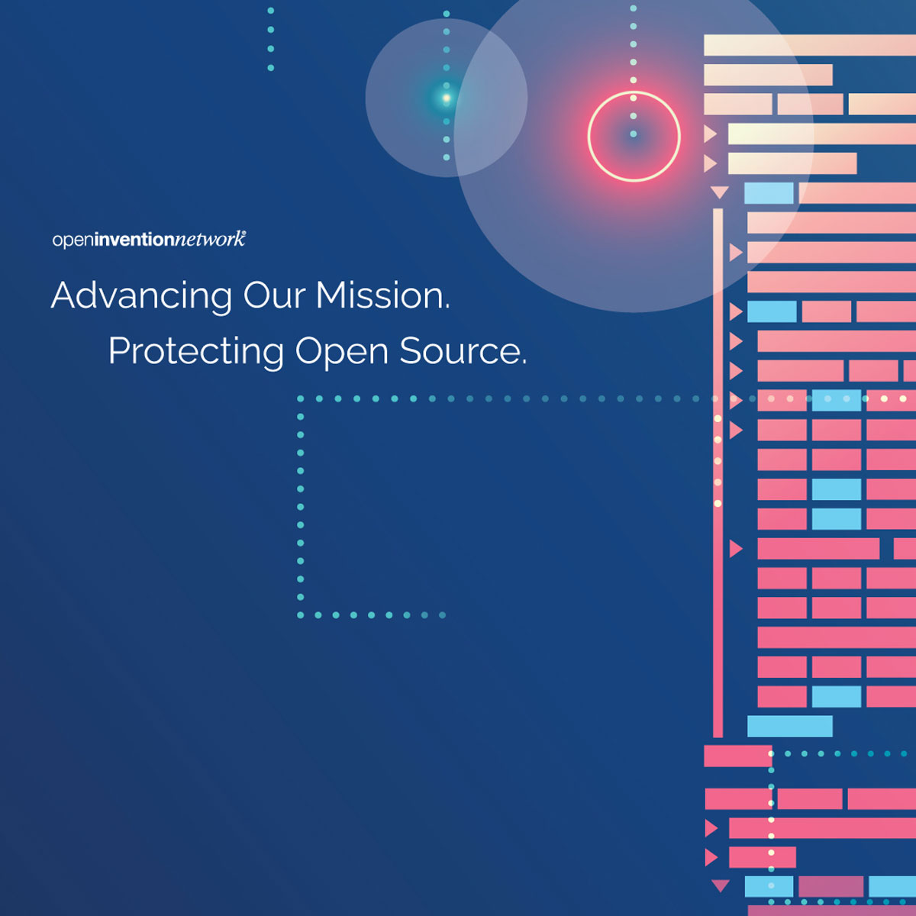
THE PATENT NON-AGGRESSION COMMUNITY
OIN’s Linux System - Ever Expanding Scope of Patent Risk Mitigation in OSS
OIN is the curator/caretaker of OSS cross license scope that enable its 4,200 plus community members to share their patents & applications with each other in the form of a cross-license whereby OIN members agree to license and not sue each other for use of their Open Source & core Linux patents - reducing friction and facilitating adoption
The coverage area — or scope of the OIN community cross-license — is defined by a list of over 5,000 core Linux & adjacent Open Source Software packages called the Linux System.
To stay up-to-date with developments in key collaborative Open Source projects, OIN periodically updates & expands the Linux System, typically on an 18-24 month cycle. AI will be included in Table 14!
‹#›

Slide 5
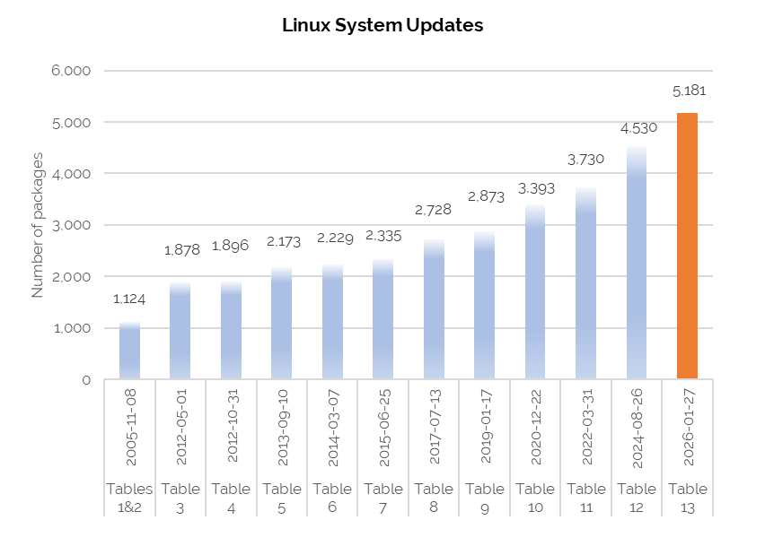

THE PATENT NON-AGGRESSION COMMUNITY
Linux System Definition — The History
*Table 13 Release Marks the Commencement of the OIN 2.0 License. Only Linux System Definition Tables 1-12 are Accessible to OIN 1.0 Licensees.
‹#›

Slide 6
THE PATENT NON-AGGRESSION COMMUNITY
Charting a More Permanent Patent Risk Mitigation Solution for OSS-
27 January 2026 Launch of OIN 2.0
‹#›

Slide 7








THE PATENT NON-AGGRESSION COMMUNITY
Patent Risk Mitigation in OSS Migrating from 20 Years of Being Subsidized by the Founding/Funding Members of OIN to an Era of Shared Responsibility Among the Broader OSS Community
OIN’s OSS Licensee Community
(Ratable Financial Support by Revenue)
‹#›

Slide 8
THE PATENT NON-AGGRESSION COMMUNITY
OIN 2.0 Licensing Program - Key Elements
Unrivaled Inclusivity so that Nominations in OSS AI Can Transform Patent Threat/Vulnerability into Insulation from AI Patent Risk
Introduction of New Tools to Identify Potential Threat/Vulnerability Based on OSS AI Adoption/Use
‹#›

Slide 9
2025CO00634
2025CO00634
THE PATENT NON-AGGRESSION COMMUNITY
OIN - Community Values and Norms that Support Collaboration/Co-opetition
CALL to ACTION - Join OIN 2.0 & Nominate Packages for License Protection
Existing OIN 1.0 Licensees - Please Become OIN 2.0 Signatories and Commit to OIN’s Self Sustainability and Permanent Presence as the Most Important Means of Ensuring Patent Risk Mitigation in OSS
&
Prospective OIN Licensees - After 20 Years, Please Now Evidence Your Commitment to Patent Risk Mitigation in OSS by Becoming a OIN 2.0 Licensee and Share the Responsibilities Associated with OSS Community Participation
OSS Provides Access to a Wholly Unique Source of Innovation! As a Beneficiary of OSS Please Recognize that with this Opportunity Comes Obligation to Adopt a Set of Community Norms/Values of Which OIN Participation is Central!
‹#›

Slide 10

Global AI-Related Issued Patents
OIN CONFIDENTIAL. THIS PRESENTATION IS INTENDED FOR INFORMATION PURPOSES ONLY AND DOES NOT CONSTITUTE LEGAL ADVICE.

Slide 11

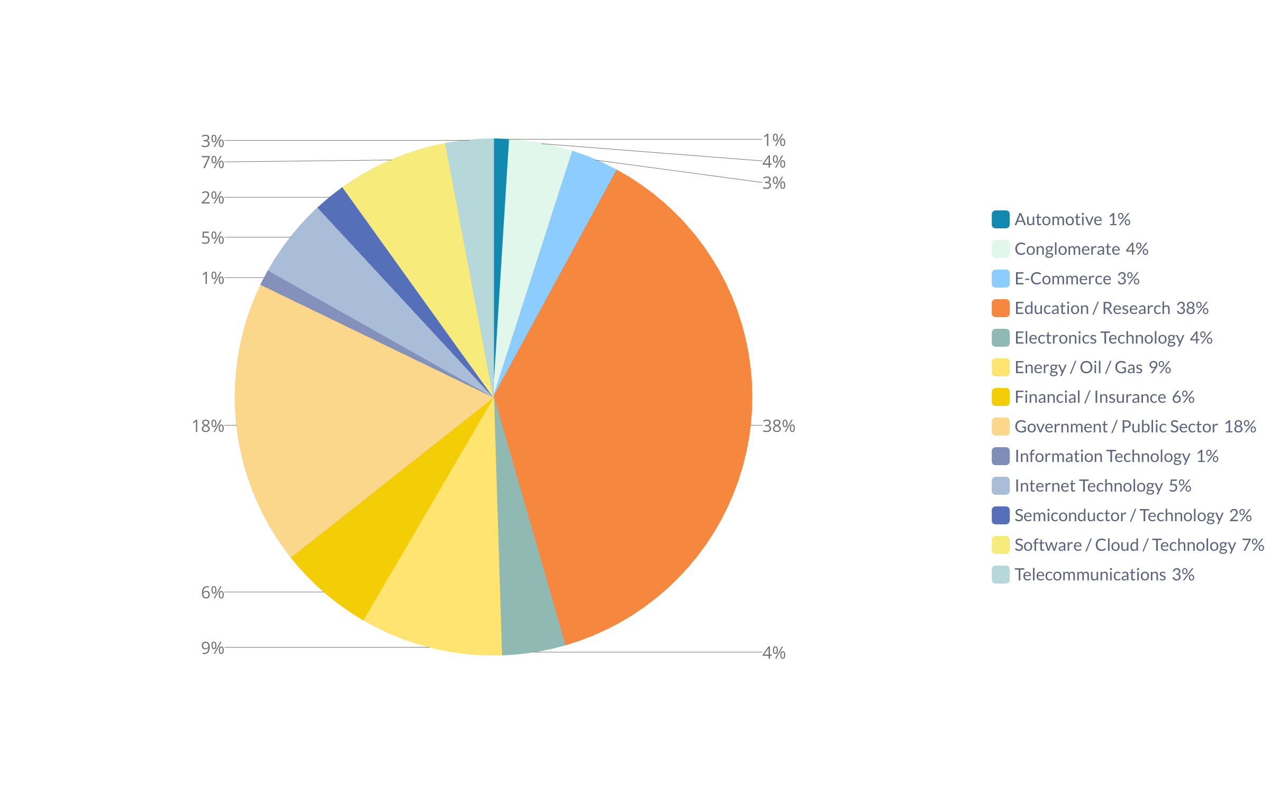


Global AI-Related Issued Patents by Sectors
March 2025
OIN CONFIDENTIAL. THIS PRESENTATION IS INTENDED FOR INFORMATION PURPOSES ONLY AND DOES NOT CONSTITUTE LEGAL ADVICE.

Slide 12

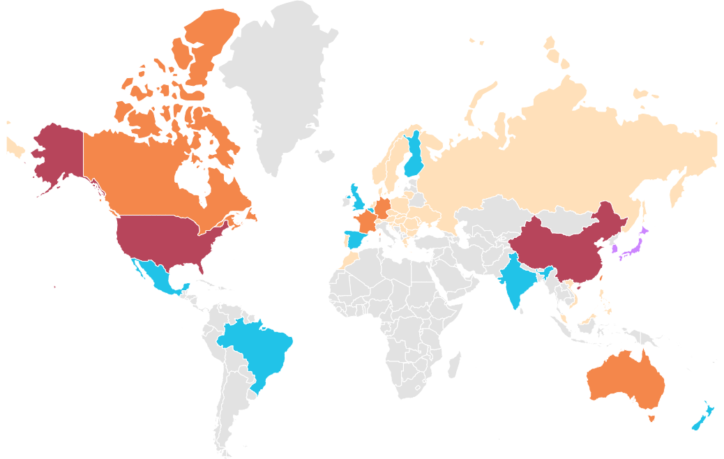


Global AI-Related Issued Patents by Country/Region
100001+
10001-100000
1001-10000
101-1000
1-100
China
United States
237008
103622
March 2025
South Korea
Japan
26488
24400
Australia
Taiwan
Germany
France
Canada
3406
2290
2263
1831
1032
TOP 5: EUROPE
VOLKSWAGEN
COMMISSARIAT A L ENERGIE ATOMIQUE ET AUX ENERGIES ALTERNATIVES
THALES
FANUC
ROBERT BOSCH STIFTUNG
Mexico
United Kingdom
Brazil
India
New Zealand
Hong Kong
Spain
Belgium
Finland
672
500
359
314
221
204
161
121
106
Vietnam
Netherlands
Portugal
Poland
Russia
Czech Republic
Greece
Sweden
Austria
Denmark
Slovenia
Morocco
Lithuania
Bulgaria
Luxembourg
Norway
Republic of Serbia
Switzerland
Malaysia
Singapore
Slovakia
Ukraine
Croatia
Philippines
Romania
Hungary
Moldova
San Marino
TOP 5: NORTH AMERICA
IBM
ALPHABET
SAMSUNG
MICROSOFT
AMAZON
85
83
71
60
50
30
28
26
25
25
22
19
16
15
14
13
12
10
9
6
6
4
3
3
2
1
1
1
TOP 5: ASIA PACIFIC
GOVERNMENT OF THE PEOPLES REPUBLIC OF CHINA
BEIJING BAIDU NETCOM SCIENCE & TECH CO
ORIENTAL POWER HOLDINGS LTD
ZHEJIANG UNIV
STATE GRID CORP CHINA
TOP 5: SOUTH AMERICA
DOWDUPONT
NIPPON STEEL & SUMITOMO METAL
NIPPON STEEL CORP
BASF
ARCELORMITTAL
TOP 3: AFRICA AND OTHER
FONDATION DE RECH DE DEV ET DINNOVATION EN SCIENCES ET INGENIERIE
ARCELORMITTAL
UNIV SIDI MOHAMED BEN ABDDELAH
OIN CONFIDENTIAL. THIS PRESENTATION IS INTENDED FOR INFORMATION PURPOSES ONLY AND DOES NOT CONSTITUTE LEGAL ADVICE.

Slide 13
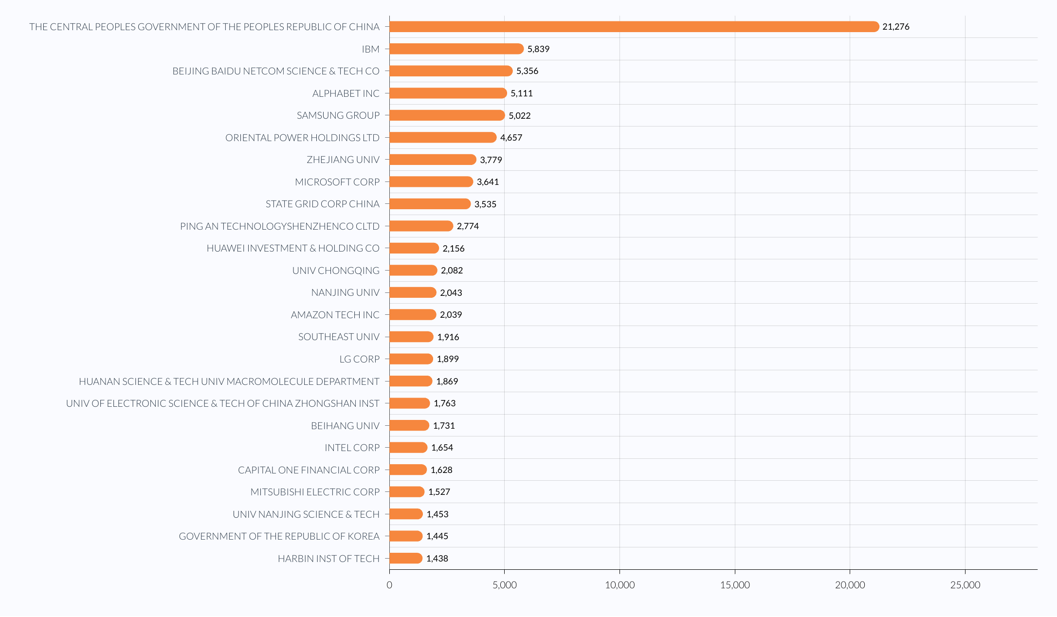
Global AI-Related Issued Patents by Top Assignees
March 2025
OIN CONFIDENTIAL. THIS PRESENTATION IS INTENDED FOR INFORMATION PURPOSES ONLY AND DOES NOT CONSTITUTE LEGAL ADVICE.

Slide 14
Global AI-Related Published Applications
OIN CONFIDENTIAL. THIS PRESENTATION IS INTENDED FOR INFORMATION PURPOSES ONLY AND DOES NOT CONSTITUTE LEGAL ADVICE.

Slide 15
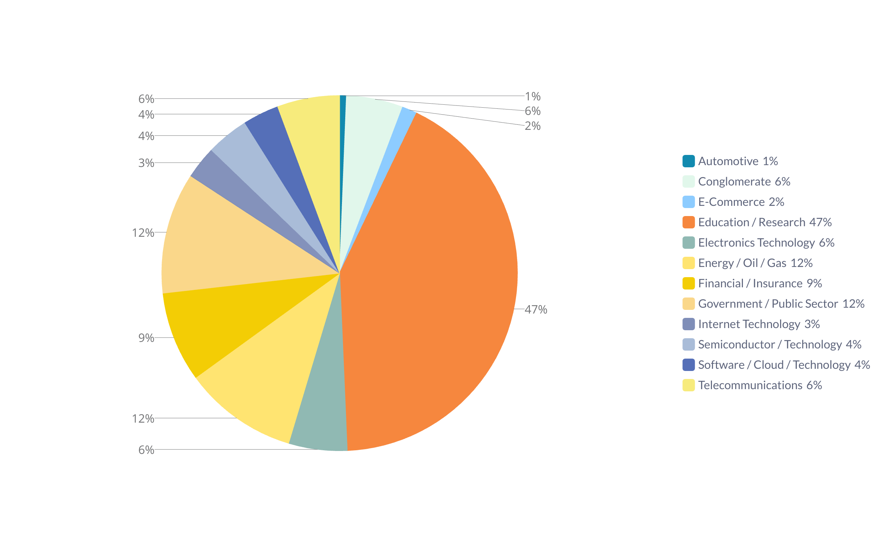
Global AI-Related Published Applications by Sectors
March 2025
OIN CONFIDENTIAL. THIS PRESENTATION IS INTENDED FOR INFORMATION PURPOSES ONLY AND DOES NOT CONSTITUTE LEGAL ADVICE.

Slide 16
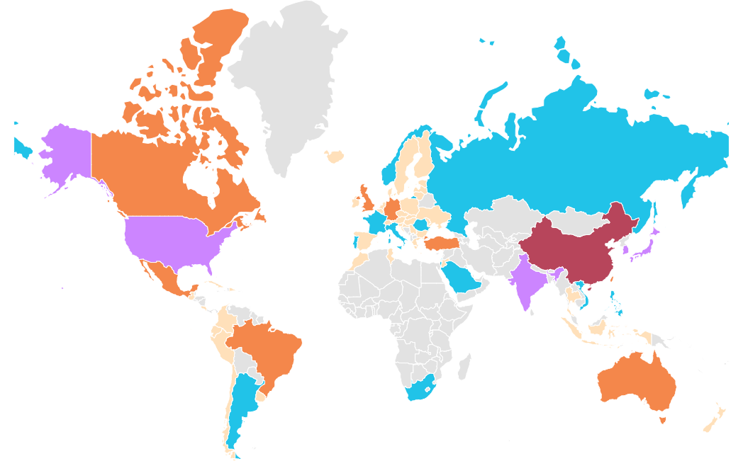



Global AI-Related Published Applications by Country/Region
100001+
10001-100000
1001-10000
101-1000
1-100
China
March 2025
295683
United States
India
South Korea
Japan
65648
55302
19919
10032
TOP 5: NORTH AMERICA
IBM
SAMSUNG
ALPHABET
MICROSOFT
NVIDIA
Germany
Canada
Mexico
Australia
Taiwan
Singapore
Brazil
Turkey
United Kingdom
TOP 5: EUROPE
ROBERT BOSCH STIFTUNG
NVIDIA
VOLKSWAGEN
BMW BAYERISCHE MOTOREN WERKE
IBM
9915
7376
4175
3637
3436
2268
1659
1339
1329
France
Israel
Vietnam
Italy
South Africa
Argentina
Luxembourg
Russia
Norway
Portugal
Philippines
Romania
Saudi Arabia
873
785
609
530
496
444
346
274
223
151
142
140
112
Switzerland
Spain
Austria
Poland
Netherlands
Republic of Serbia
Sweden
Hungary
Czech Republic
Thailand
Slovenia
Croatia
Ukraine
Hong Kong
Indonesia
Chile
Colombia
Ireland
Belgium
Morocco
Slovakia
Tunisia
Moldova
Lithuania
80
72
69
63
57
52
52
48
47
47
39
35
35
27
27
25
23
16
15
15
15
14
12
11
TOP 5: ASIA PACIFIC
GOVERNMENT OF THE PEOPLES REPUBLIC OF CHINA
STATE GRID CORP CHINA
ORIENTAL POWER HOLDINGS
SAMSUNG
ZHEJIANG UNIV
9
7
3
3
3
3
2
2
2
2
1
1
1
1
1
1
1
1
Denmark
Bulgaria
Costa Rica
Ecuador
Estonia
Greece
Dominican Republic
Iceland
Latvia
Peru
ARIPO
Cuba
Finland
Guatemala
Jordan
Monaco
New Zealand
Uruguay
TOP 5: SOUTH AMERICA
QUALCOMM
BASF
DOWDUPONT
HUAWEI INVESTMENT & HOLDING CO
MONSANTO CO
TOP 5: AFRICA and OTHER
TURKCELL TECH RES & DEV CO
GOVERNMENT OF SAUDI ARABIA
TUERK TELEKOMUENIKASYON ANONIM SIRKETI
ILLUMINA
MAGIC LEAP
OIN CONFIDENTIAL. THIS PRESENTATION IS INTENDED FOR INFORMATION PURPOSES ONLY AND DOES NOT CONSTITUTE LEGAL ADVICE.

Slide 17
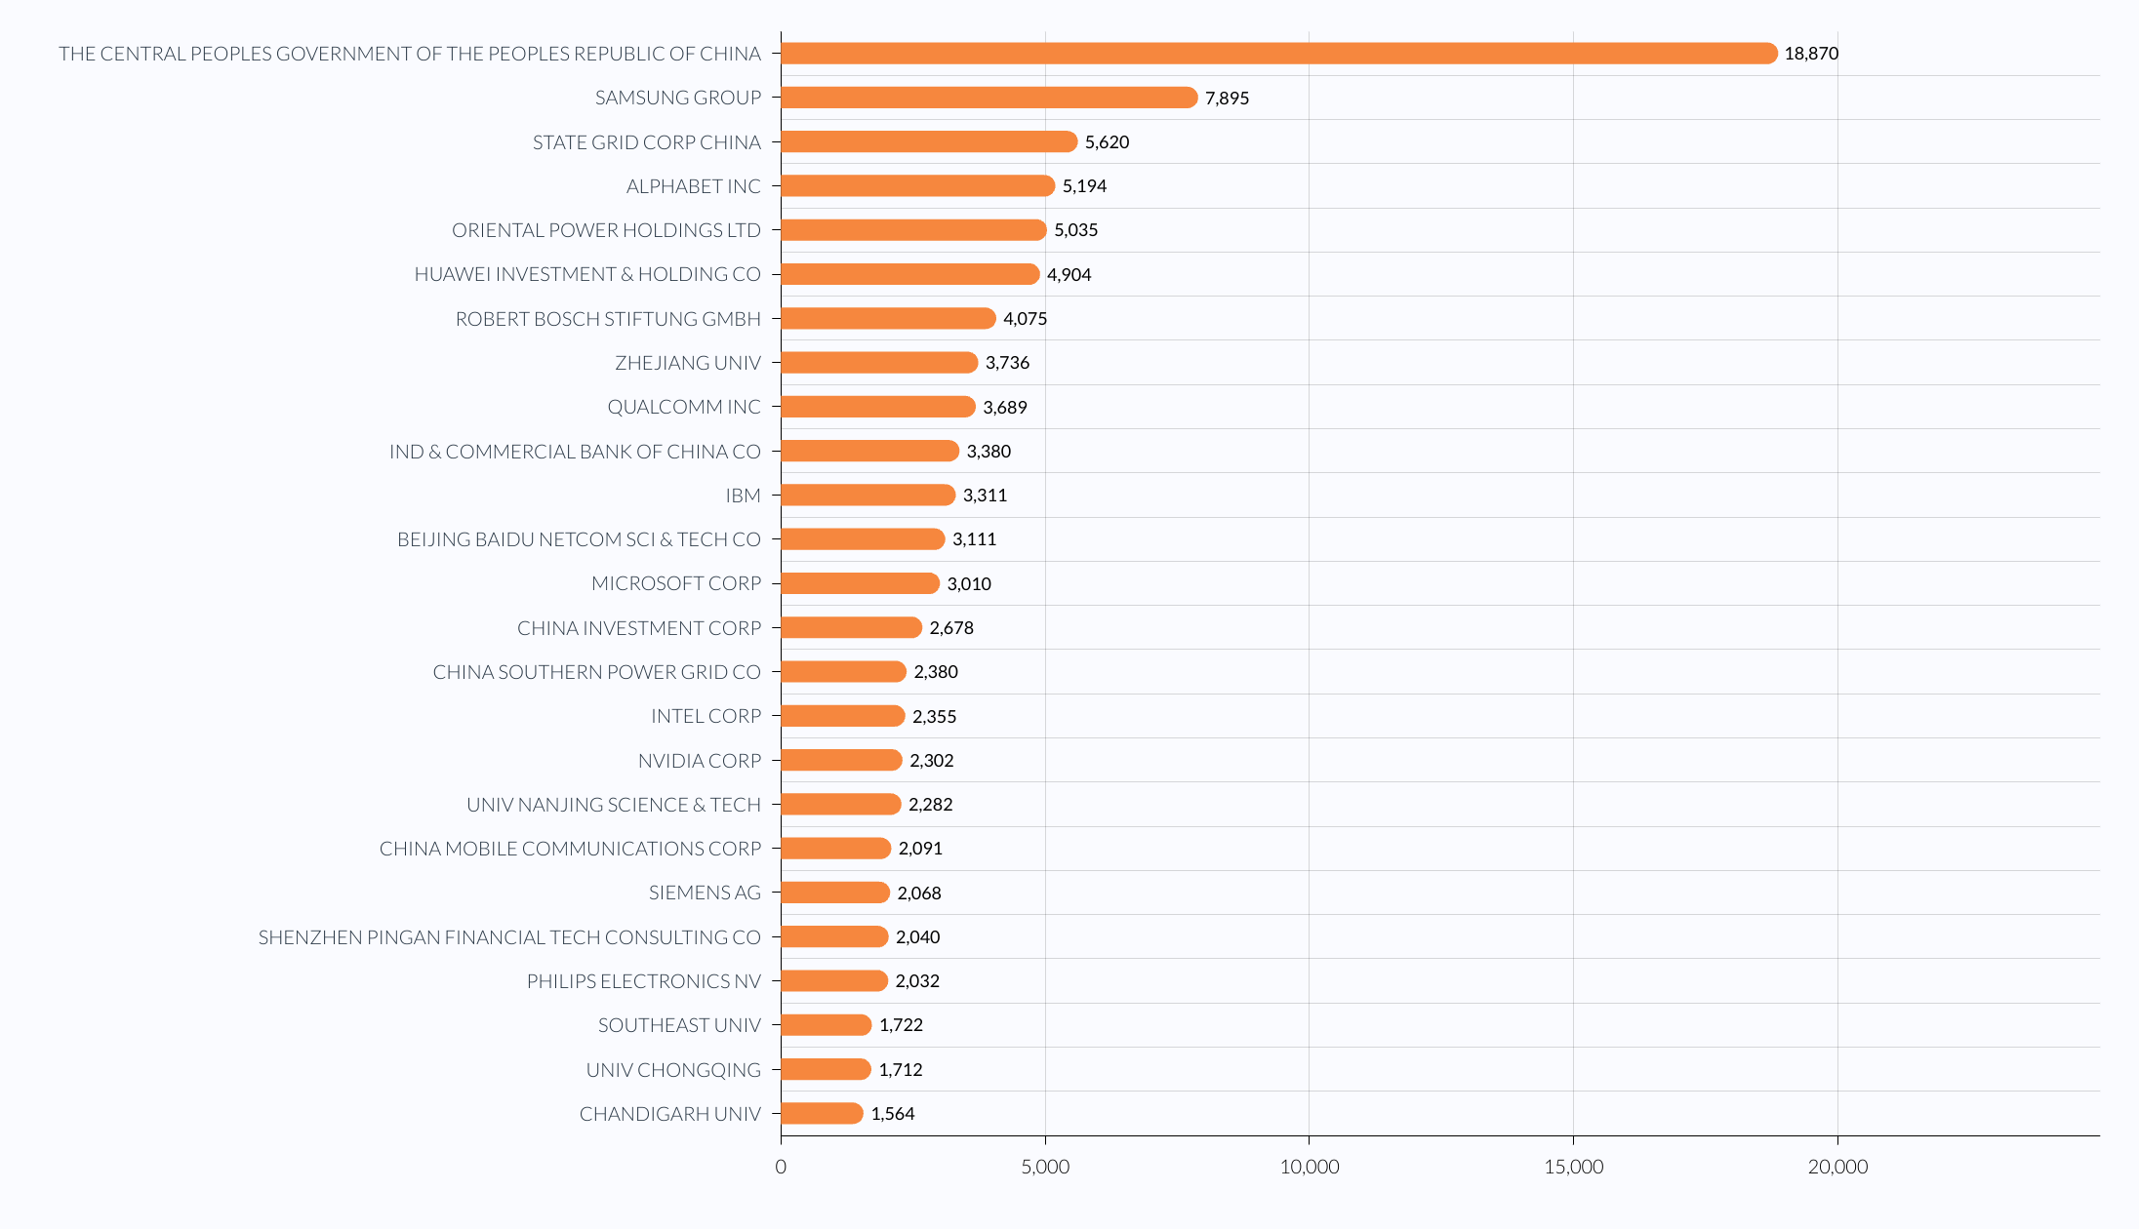
Global AI-Related Published Applications by Top Assignees
March 2025
OIN CONFIDENTIAL. THIS PRESENTATION IS INTENDED FOR INFORMATION PURPOSES ONLY AND DOES NOT CONSTITUTE LEGAL ADVICE.

Slide 18
THE PATENT NON-AGGRESSION COMMUNITY
OIN As a Model for Success and Emulation - Complements to OIN
AI Patent Consortium Cross-License (SAIL) - Meta-led initiative to mitigate patent risk associated with AI Foundation Models at launch - Q2 2026
Open Hardware Patent Risk Mitigation Working Group - Google, Meta and Alibaba-led initiative to mitigate patent threats to RISC-V and beyond in Open Hardware - early-mid 2027 (anticipated launch)
OIN is More than Just a Community As It Is Emerging as a Model to be Adapted to Reduce Patent Risk in Other Contexts/Communities
‹#›

Slide 19
Keith Bergelt
Chief Executive Officer
kbergelt@openinventionnetwork.com

