Slide 1

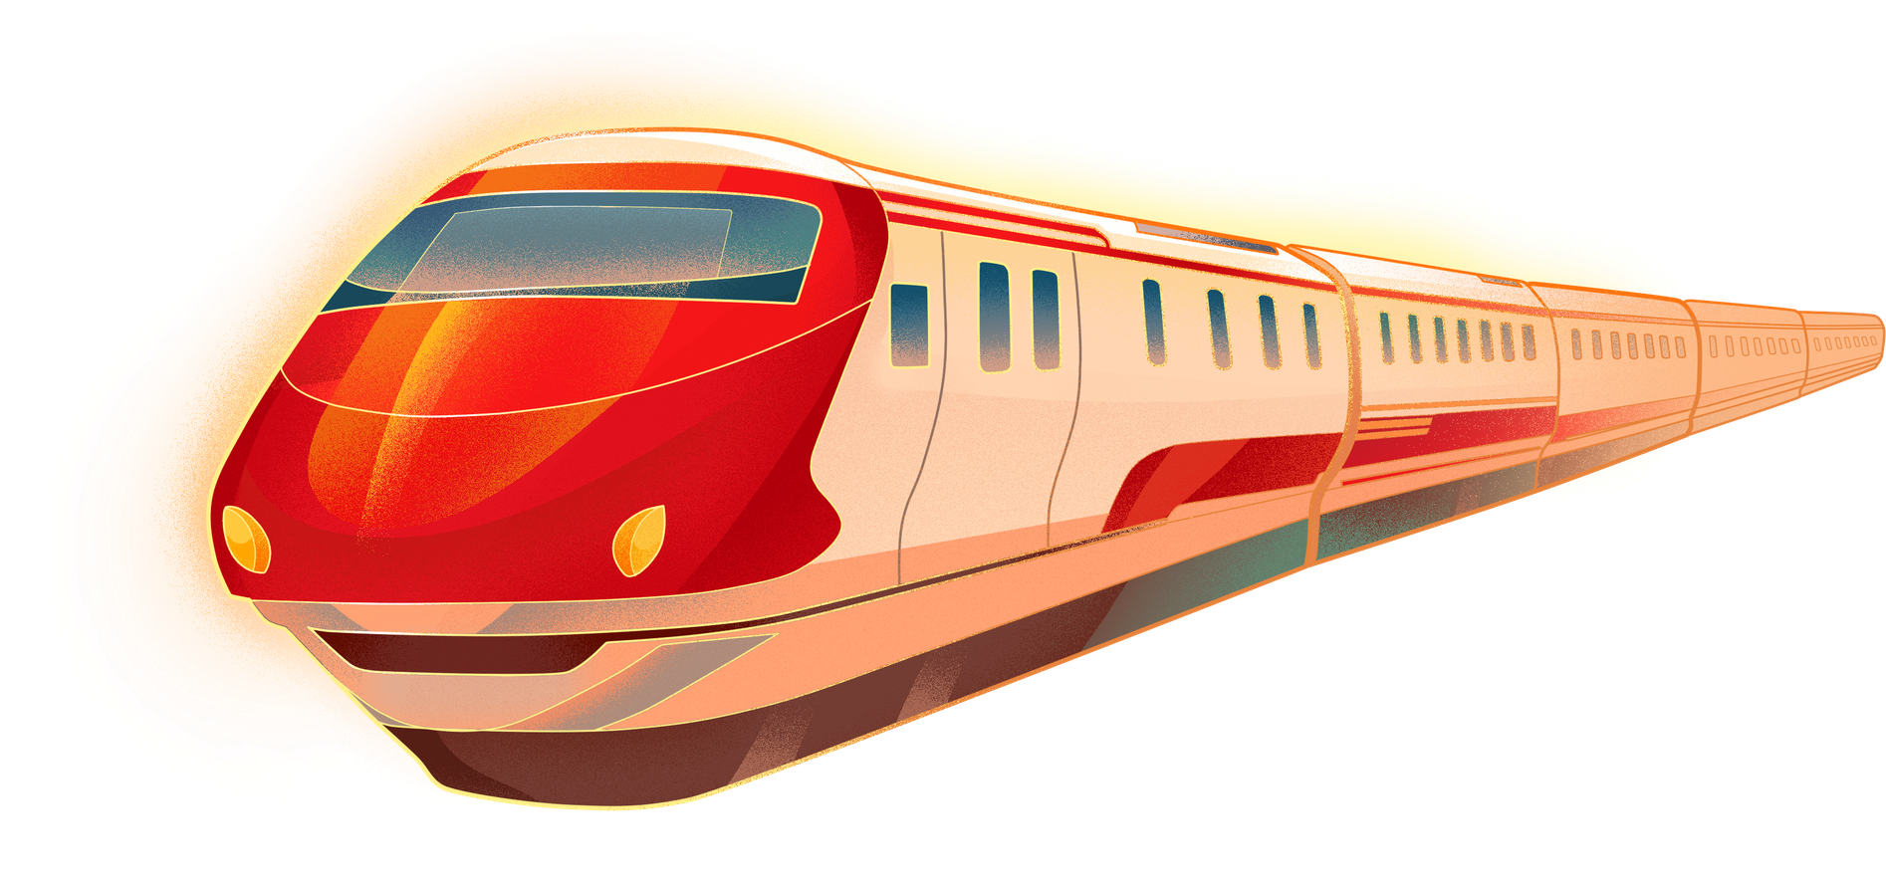
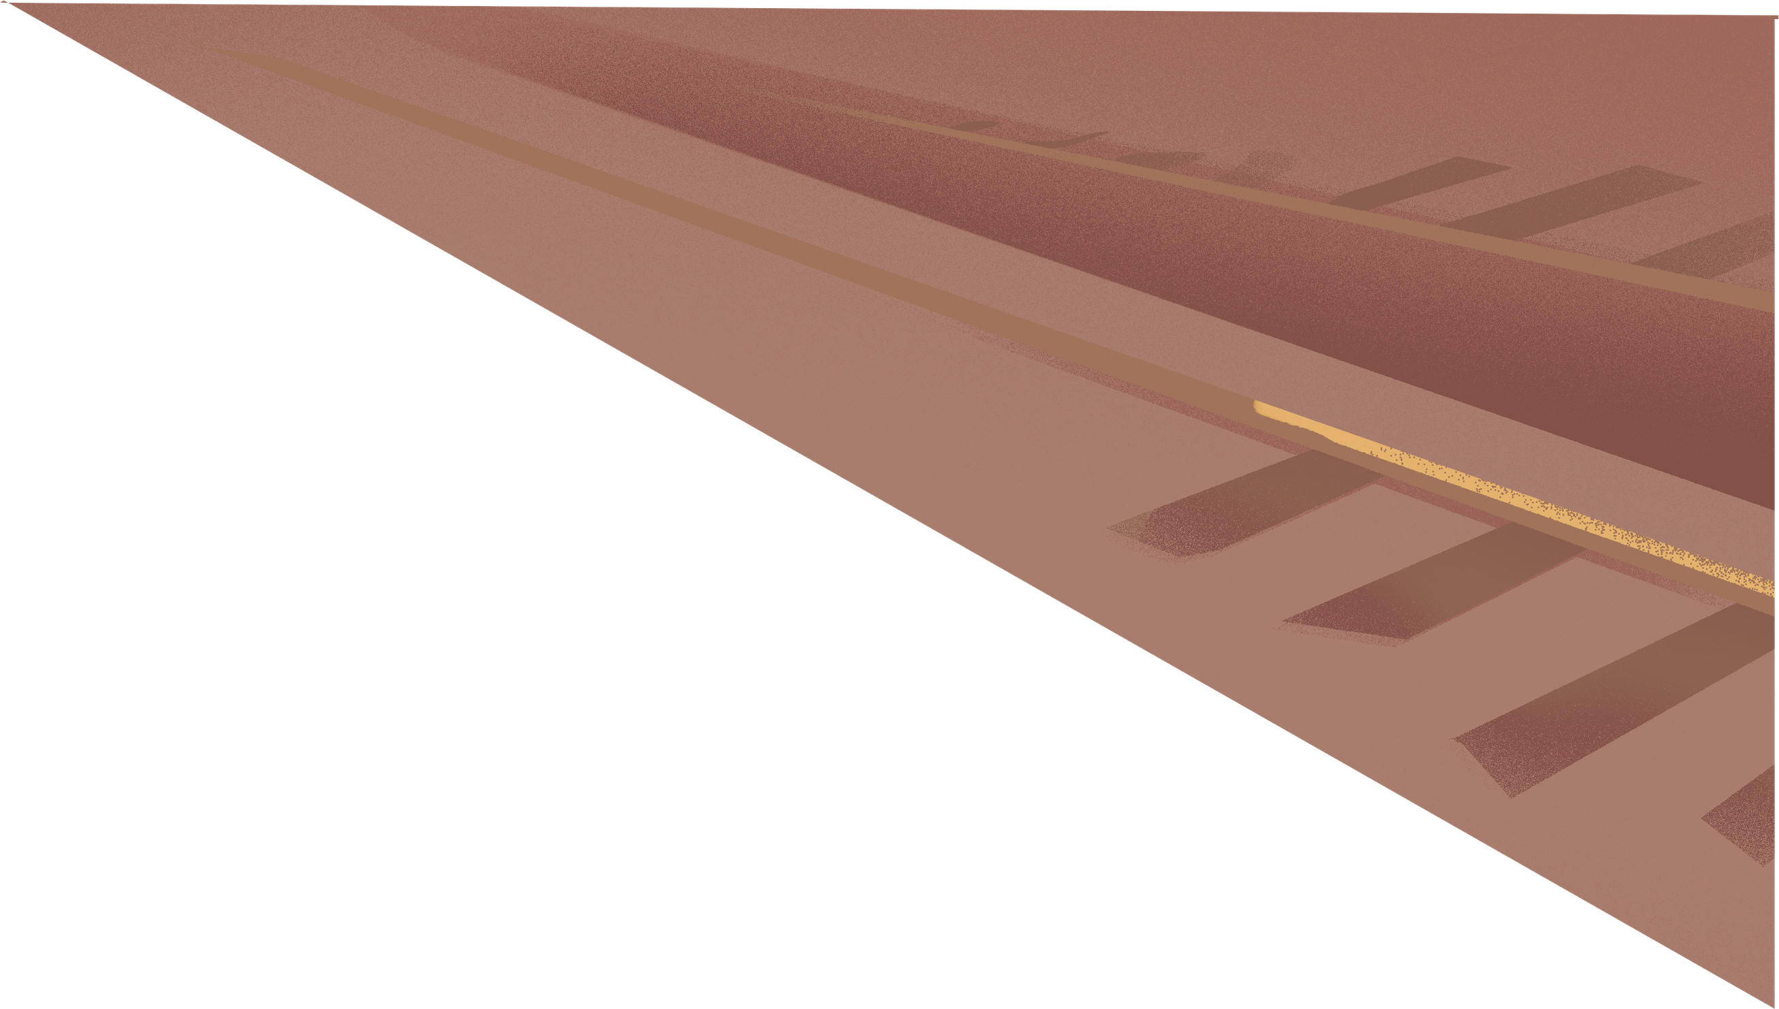

How infrastructure engineers unlock true enterprise Value
Presented by Briana Faulk

Slide 2
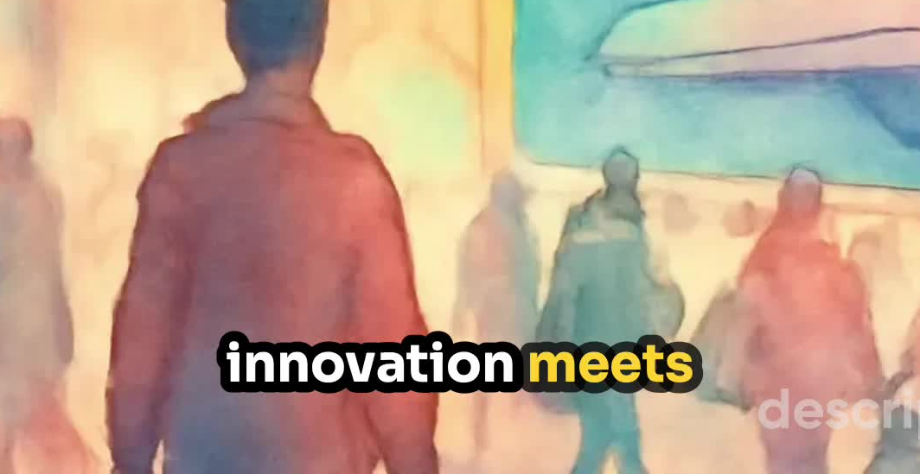
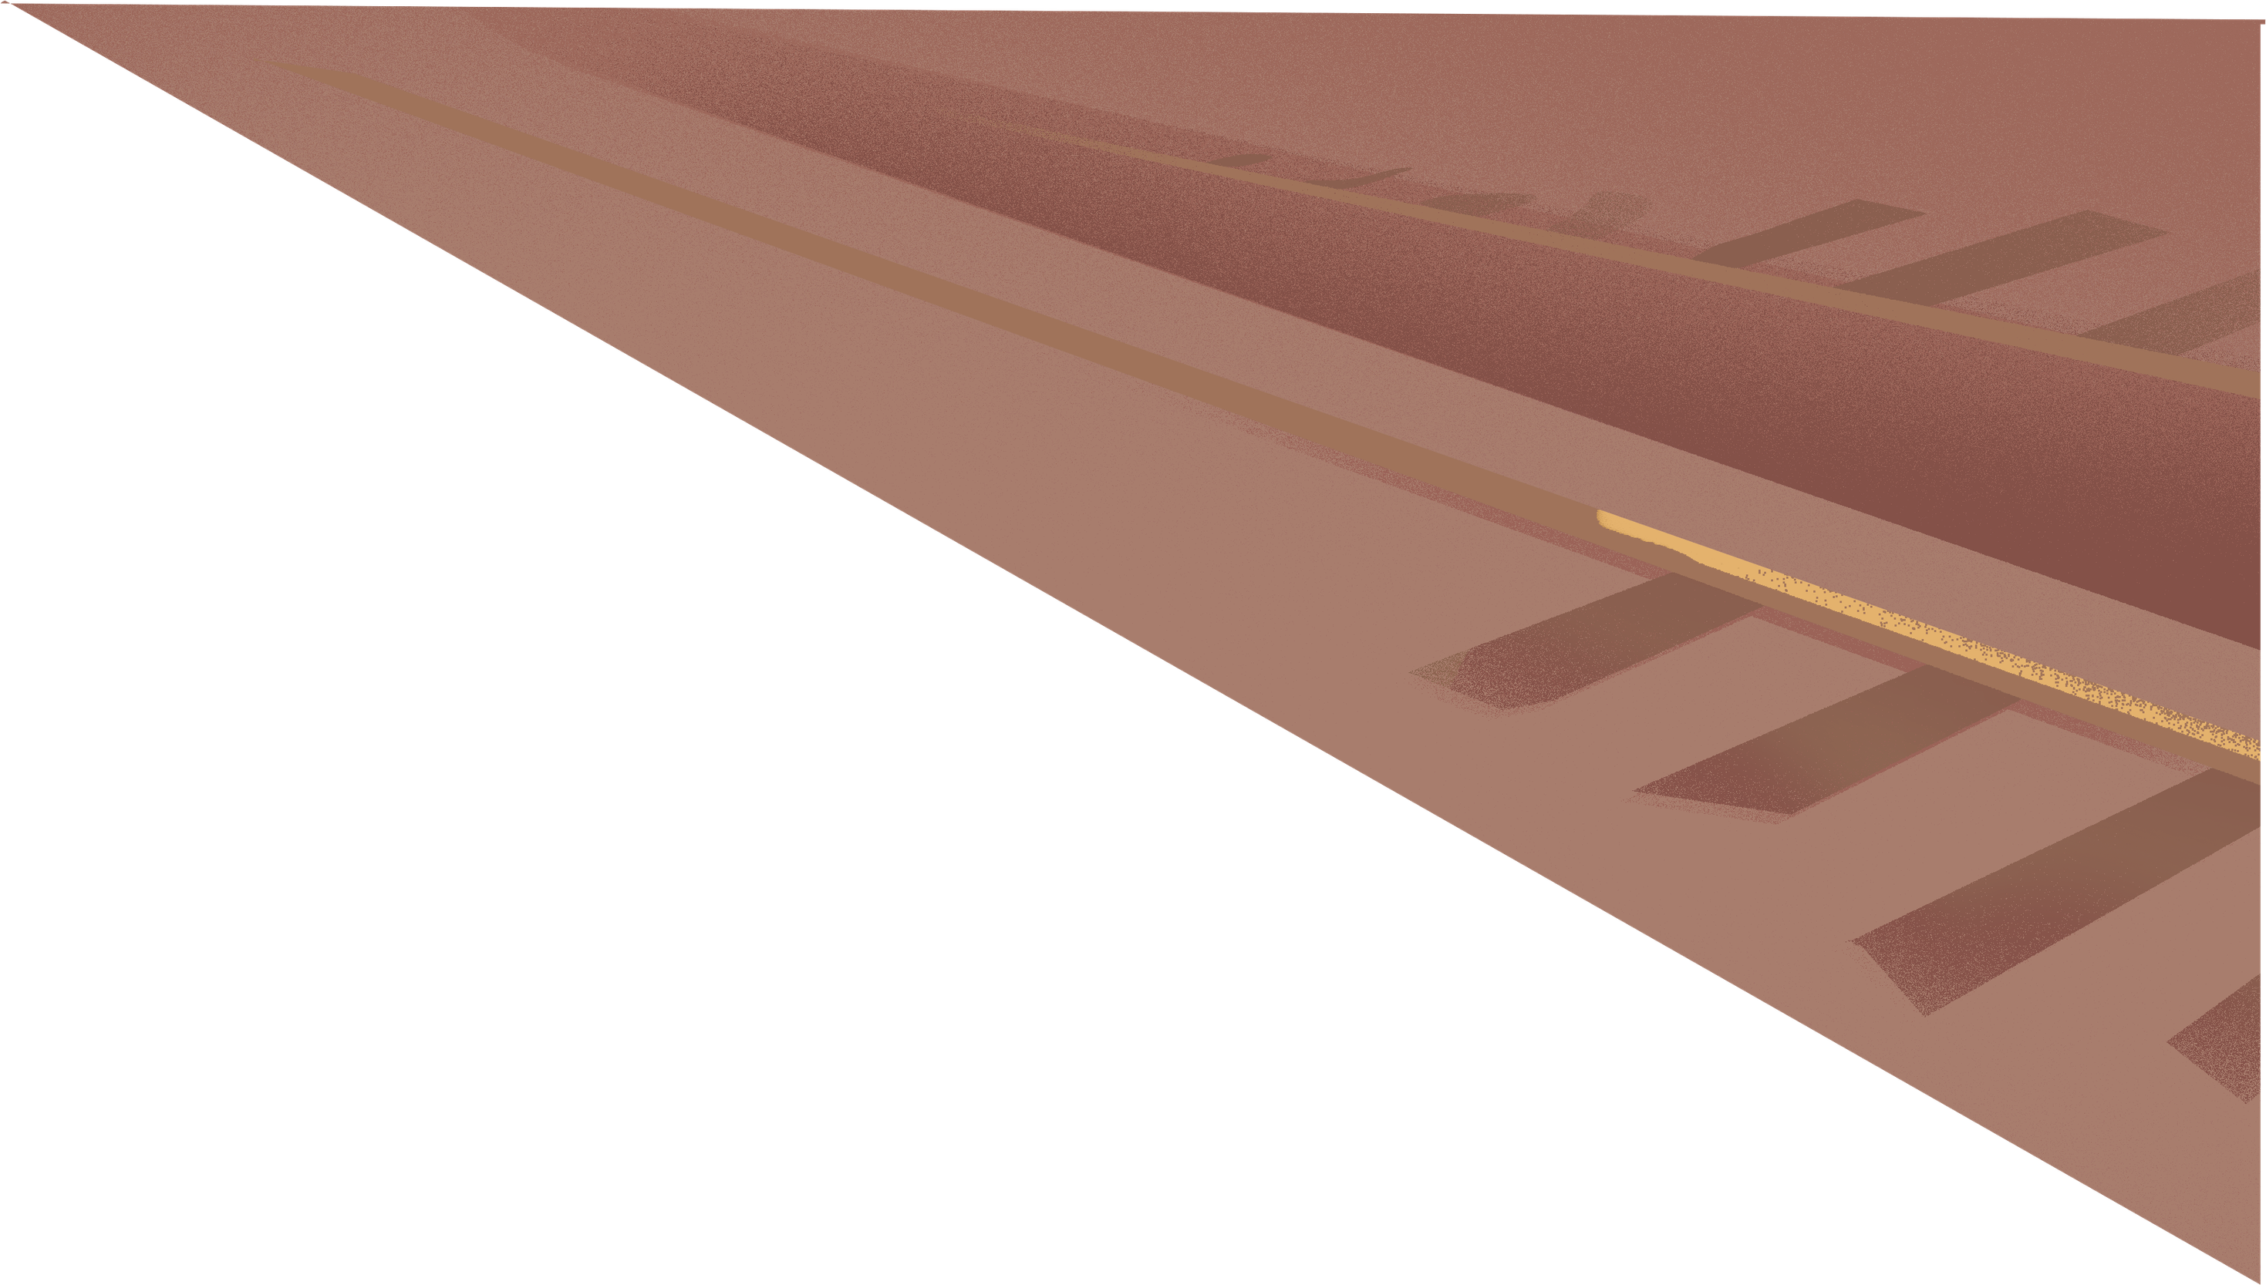

Slide 3

Agenda
  Past infrastructure innovation
  Current network infrastructure challenges
  Current Cybersecurity infrastructure challenges

Slide 4
How U-Net Changed Everything
  The Breakthrough: RDMA’s[Remote Direct Memory Access] current success in AI and supercomputing clusters is built on the technical groundwork of U-Net, developed by Thorsten von Eicken.
  From Theory to Scale: This evolution bridged the gap between theoretical high-performance networking and the massive, scalable cloud infrastructure used by enterprises in 2026.
Notes:
Sources: https://network.nvidia.com/pdf/whitepapers/WP_Why_Compromise_10_26_06.pdf

Slide 5
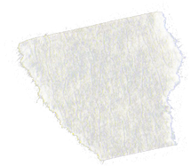


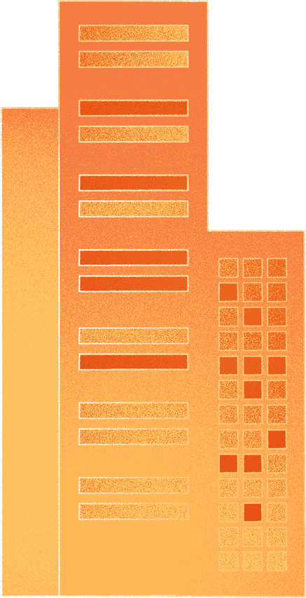
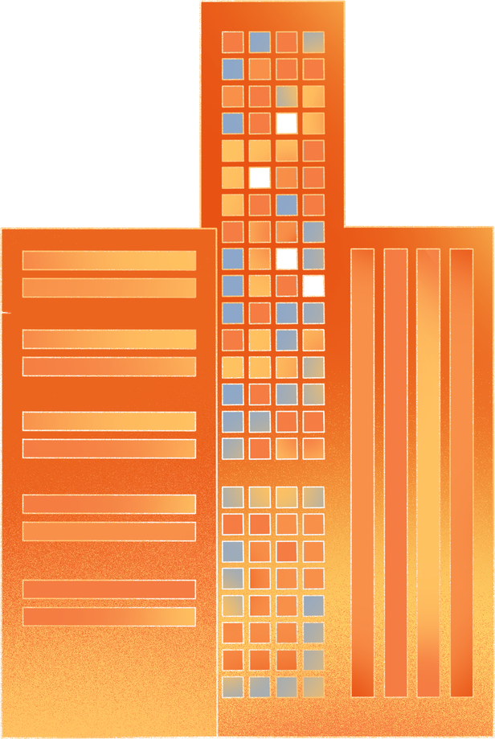


The Physical Bottleneck: Fiber & Copper Limits
  Legacy Issues: Rural areas remain capped by the physical properties of copper/coax, which suffer from signal decay and asynchronous speed limits.
  The Fiber Shortage: Despite fiber’s speed, a "perfect storm" of AI data center construction and rural broadband projects has pushed lead times for high-density ribbon fiber to over 60 weeks.
Notes:
https://www.linkedin.com/pulse/looming-fiber-shortage-2026-james-j-dimmer-iii-ki5ze/
https://www.benton.org/headlines/here’s-how-big-fiber-shortage-really

Slide 6
Implementing Post-Quantum Cryptography (PQC)
  The Performance Tax: PQC carries much heavier computational overhead and larger packet sizes. Without proper implementation, this security layer can "choke" high-speed networking fabrics and destroy AI performance.
  Holistic Security: Success requires engineers who can secure the entire stack—ensuring that the physical networking devices are optimized to handle PQC loads without compromising the application layer's speed.
Notes:
Source: https://nvlpubs.nist.gov/nistpubs/ir/2024/NIST.IR.8547.ipd.pdf

Slide 7
The Tech Mind Shift
Is this problem an infrastructure issue?

Slide 8


Scan to stay connected
Thank
You
Presented by Briana Faulk
Notes:
Link: https://linktr.ee/britheengineer

