Slide 1


Let Your Net…Work
Networking that actually leads somewhere —
real conversations, real momentum.
PRESENTED BY SARAH FINNERTY

Slide 2

Most Networking Doesn't Work
Too Many People
No Structure
No clear reason to talk to anyone in particular.
Conversations drift. Nothing actionable comes out.
No Follow-Up
Nice energy in the room — then silence after.
👉 It's not you. It's the structure.

Slide 3


Magnet Flips the Model
The Old Way
The Magnet Way
"What do you do?" — hollow openers, surface talk
"What do you need?" — direct, purposeful, human
Talking → hoping — say your pitch, cross your fingers
Helping → connecting — lead with generosity, earn trust
Volume over value — collect cards, convert nothing
Better questions = better outcomes — every time

Slide 4
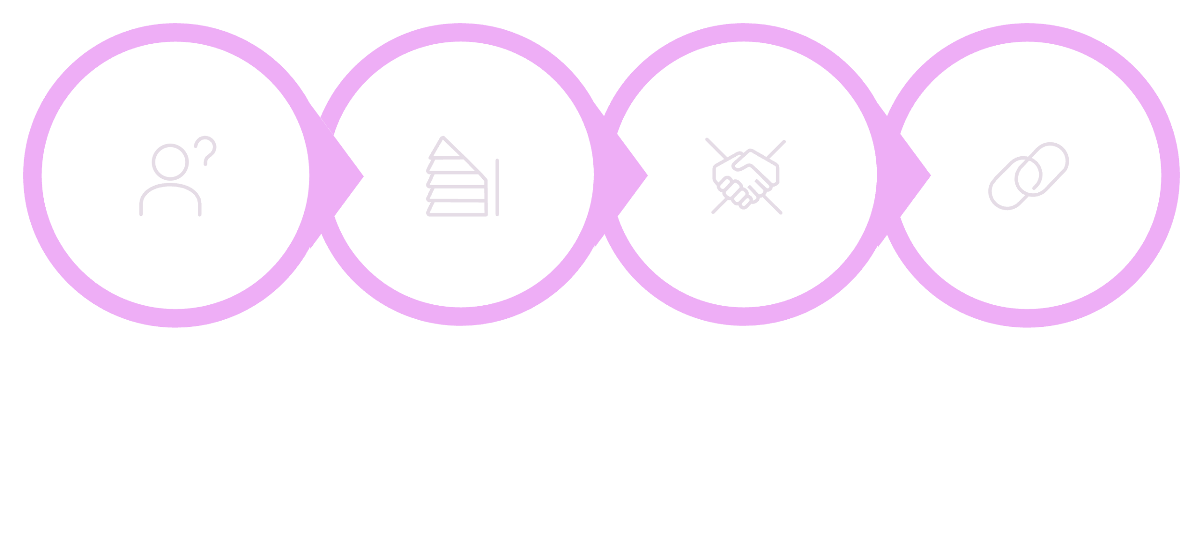




How Magnet Works
Write Ask
Post It
Offer Help
Connect
You walk out with actual next steps —
not just a stack of cards and a vague plan to follow up "sometime."

Slide 5
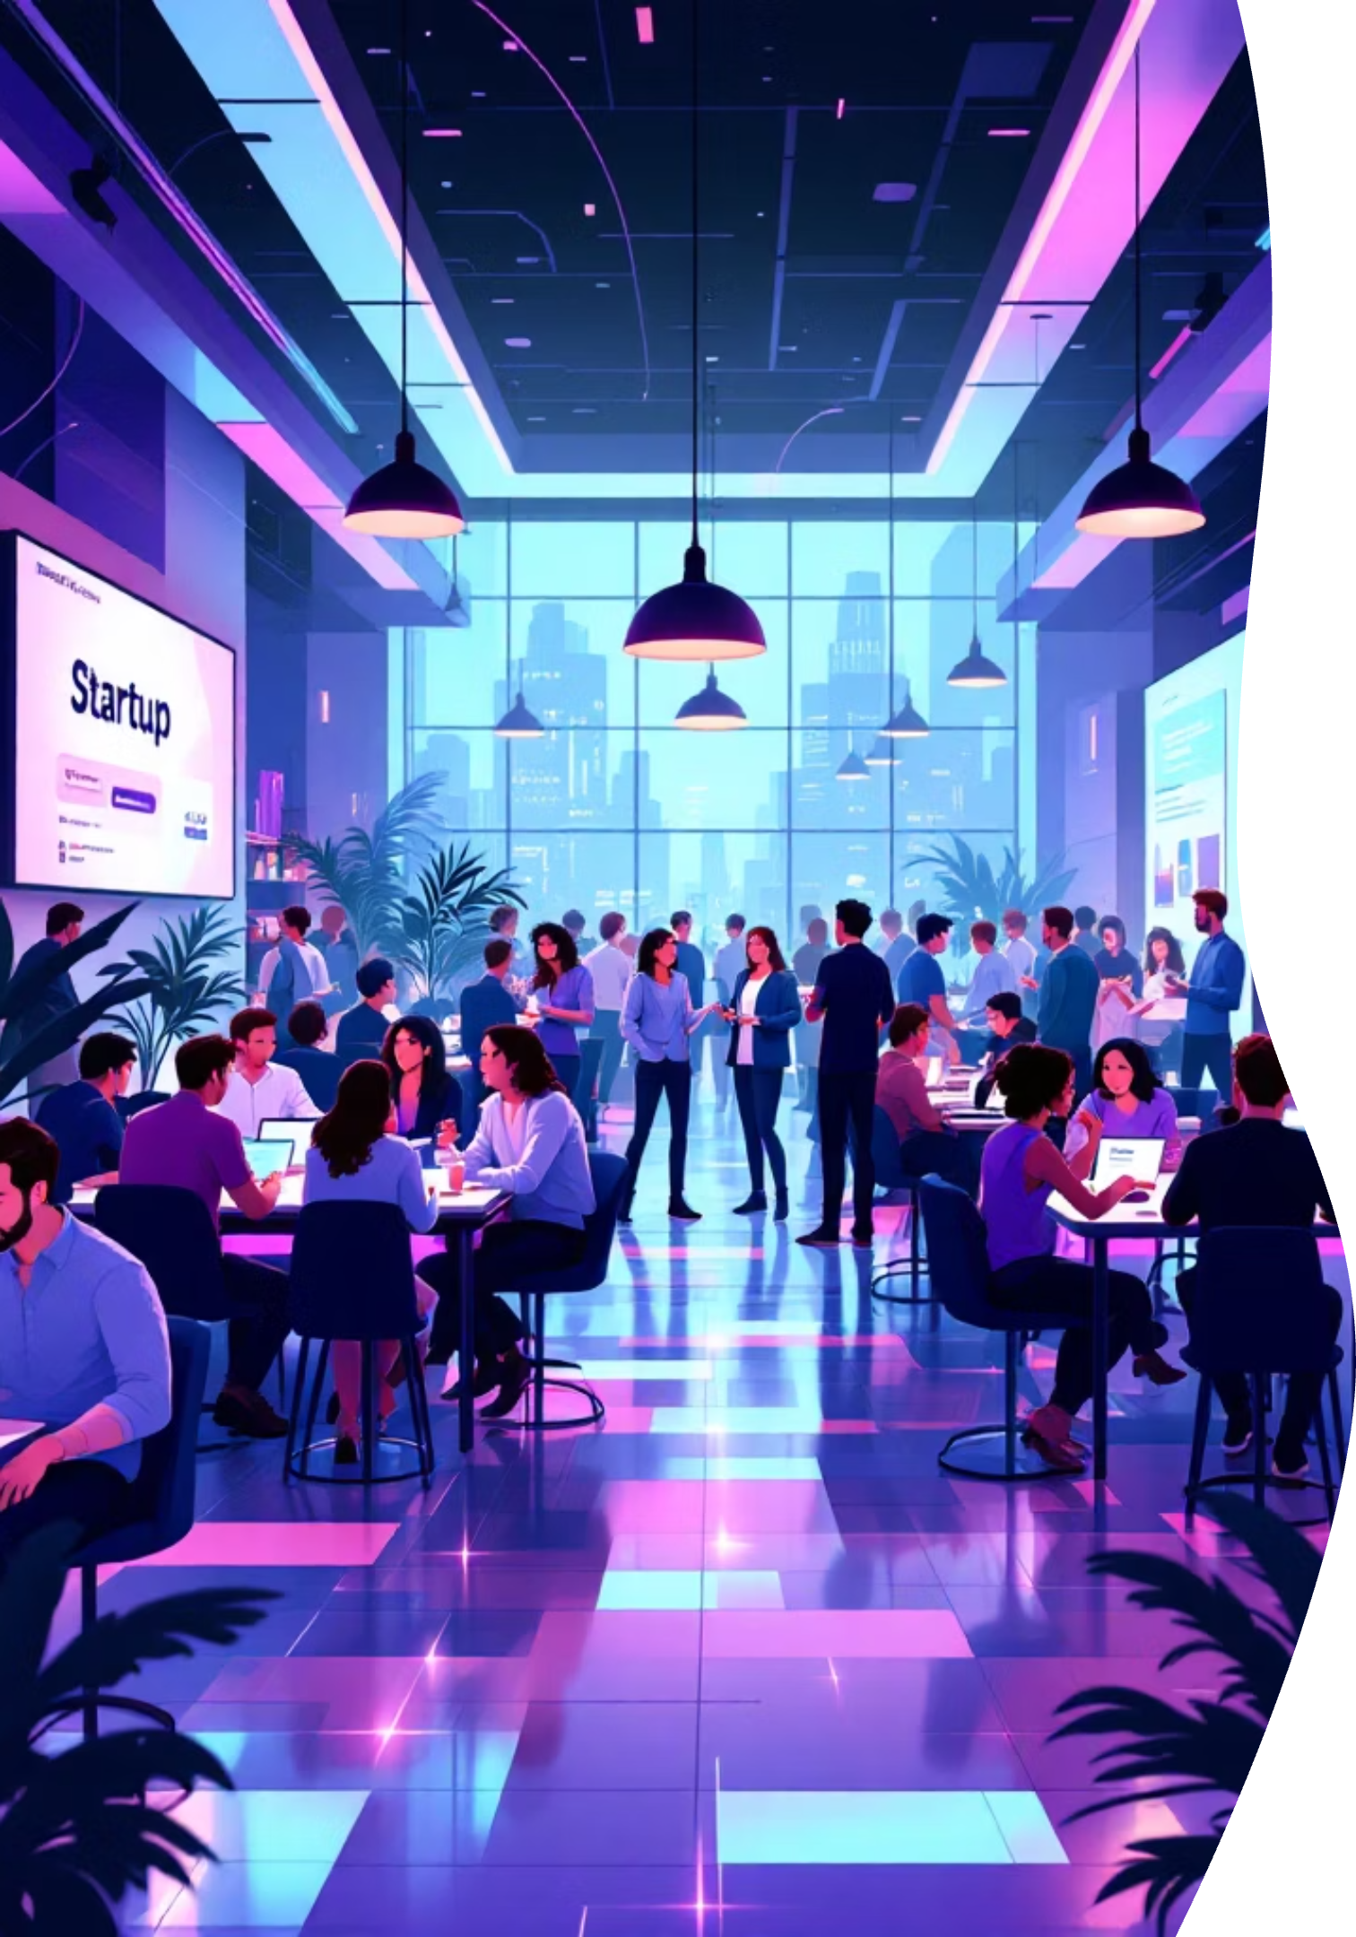



Come Try It
Tired of "nice but nothing happens" events?
Magnet is different — and it starts the moment you walk in.
Bring One Clear Ask
Leave with Real Connections
Show up knowing what you need.
People who can actually help — and want to.
Follow-Up Already Started
No awkward "we should grab coffee" limbo.

Slide 6
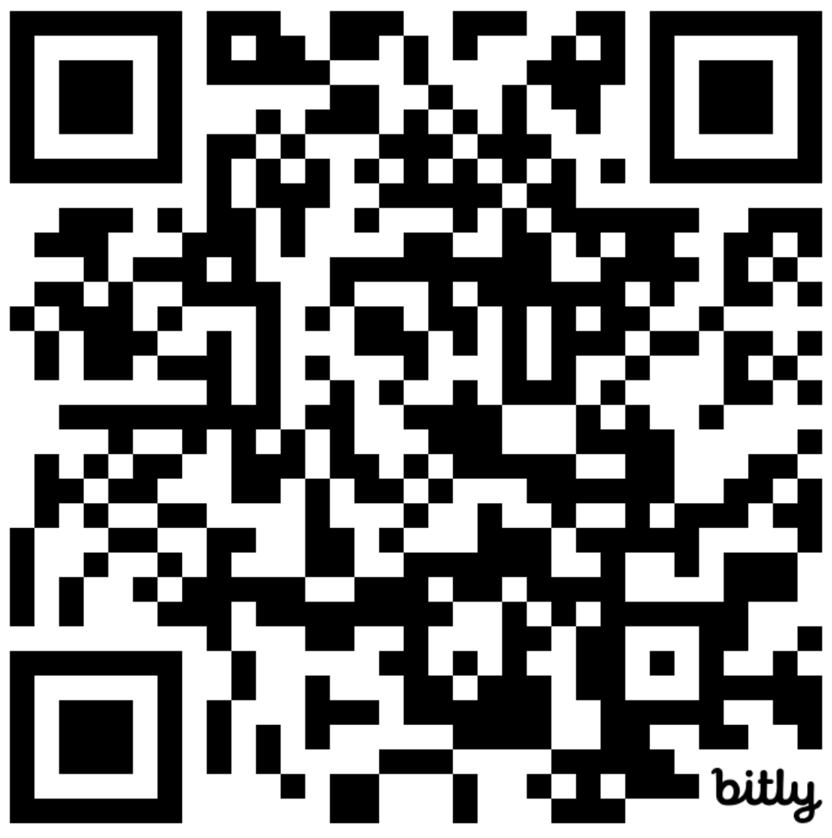
Join Our Next Event!
April during Raleigh-Durham Startup Week —
Time and place TBD.
Scan the code below to join the mailing list and get details of all upcoming events.

