Slide 1
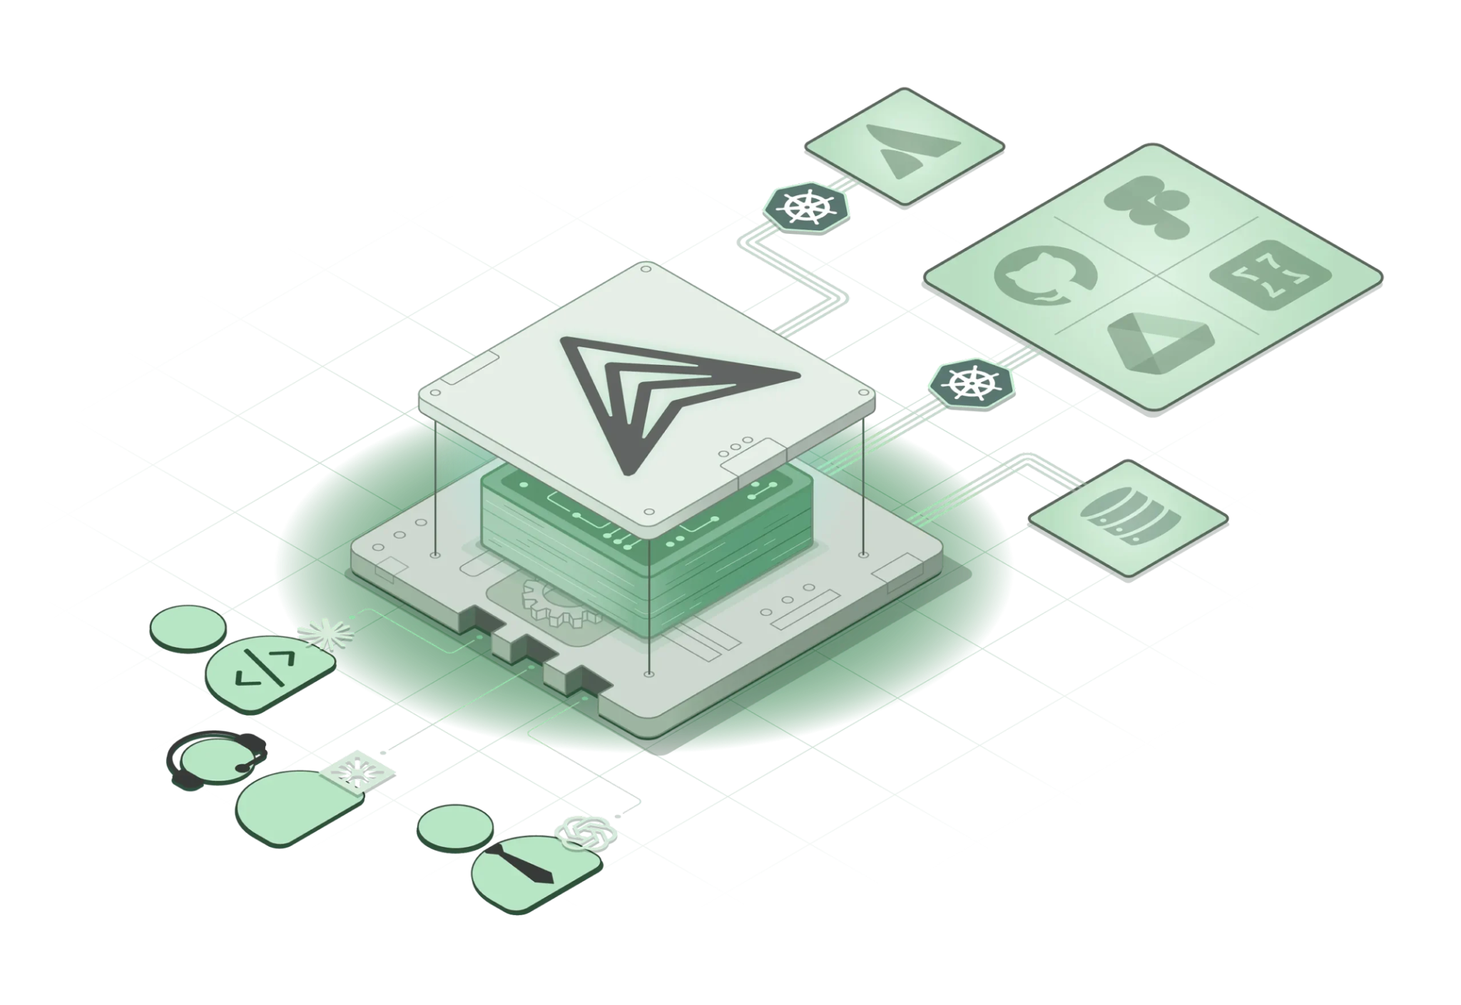
Context and boundaries
March 2026
Craig McLuckie
CEO & Founder, Stacklok
Co-founder, Kubernetes project

Slide 2
Hard Systems, Soft Systems
Hard code is versioned, linted, tested, gated, observed
You are accountable for the behavior of hard systems
Soft code is the dynamic by-product of agentic work
Notes:
You are responsible for the behavior of hard systems, and as a result have put a lot of effort into creating a hardened framework
Turns out you are also responsible for the behavior of soft systems, and more terrifyingly we are letting the boundary erode.

Slide 3
Hard Systems, Soft Systems
Hard code is versioned, linted, tested, gated, observed
You are accountable for the behavior of hard systems
Soft code is the dynamic by-product of agentic work
Turns out you are also accountable for the behavior of soft systems
Boundary between hard and soft is currently undefined and ungoverned.
Notes:
You are responsible for the behavior of hard systems, and as a result have put a lot of effort into creating a hardened framework
Turns out you are also responsible for the behavior of soft systems, and more terrifyingly we are letting the boundary erode.

Slide 4

What could possibly go wrong?

Slide 5
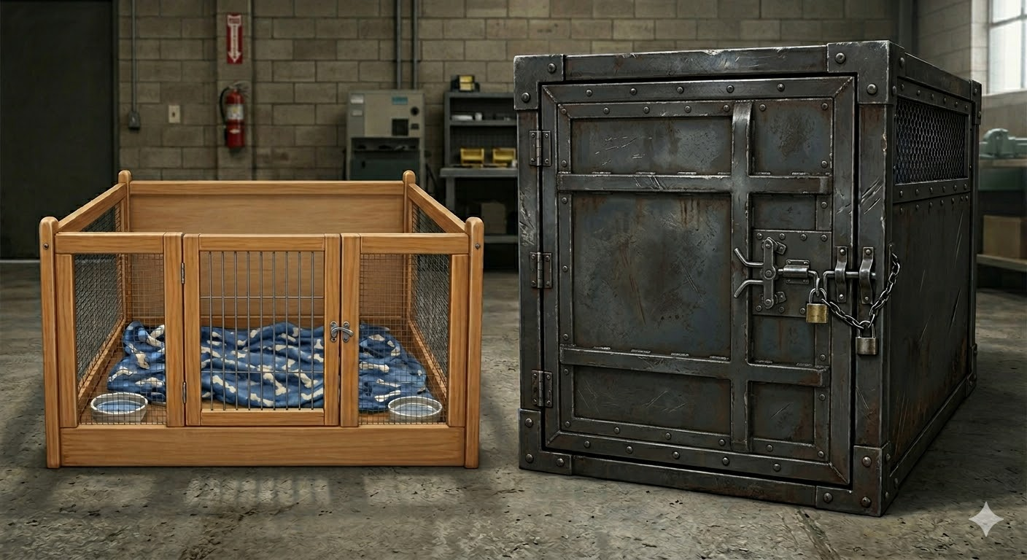
What could possibly go wrong?

Slide 6
Sanity strongly suggests …
Soft code must be formally and fully isolated
Run w/ minimal permissions
Formalize interactions w/ hard systems: transparency and reconcilability
Which suggests you are going to need a formal protocol to connect hard and soft systems.
MCP isn’t perfect, but it fits the bill.

Slide 7
MCP Isn't Dead, It's Hard
Identity passthrough is operationally demanding
Context optimization is an exercise to the reader
Semantic coupling of tools to task creates challenges
Agentic runtime isolation isn’t much talked about

Slide 8
Looking forward …
Cloud native renders really strong building blocks…
Kubernetes (as control plane).
SPIFFE (flexible agentic identity).
Micro-VMs (for isolation).
Toolhive (making MCP first class k8s concept)

Slide 9
Thank you!
Check us out at https://stacklok.com
Hit me up on LinkedIn (Craig McLuckie)

