Slide 1
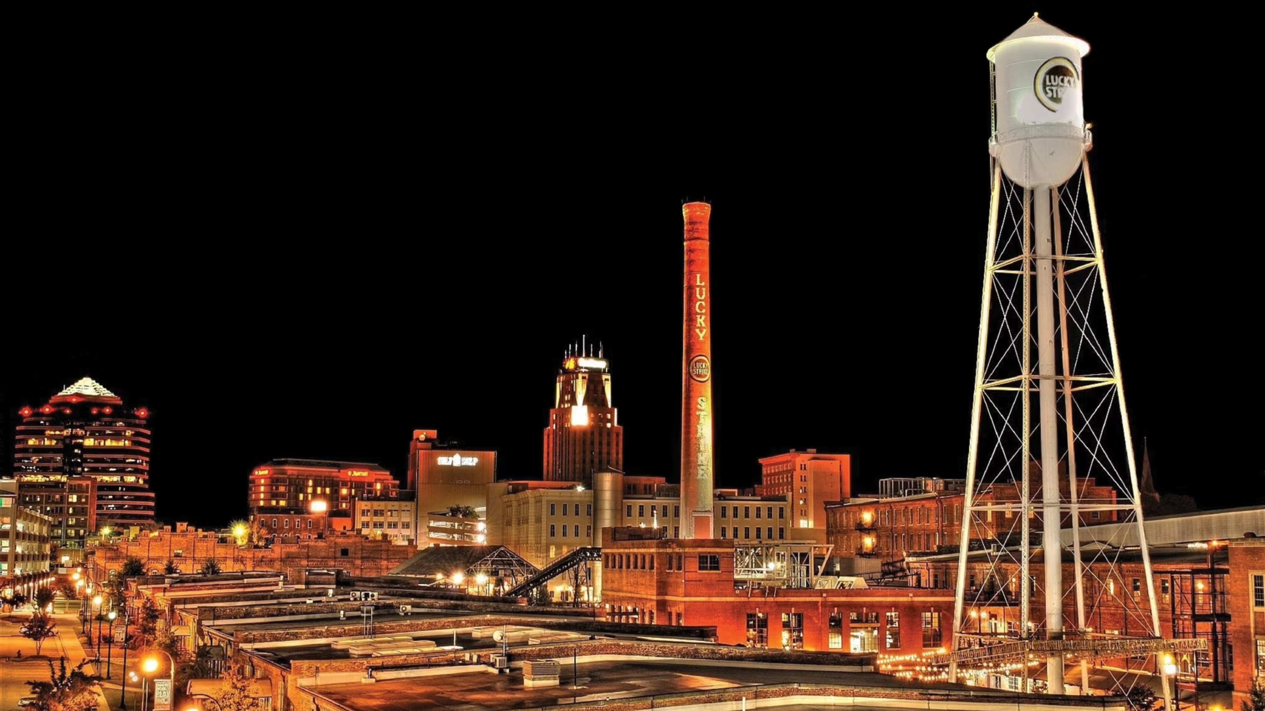
Community as Infrastructure in the Age of AI
Dena Guvetis, Executive Director — American Underground

Slide 2

AI = Location doesn't matter
That's what everyone believes. It's just not true.

Slide 3
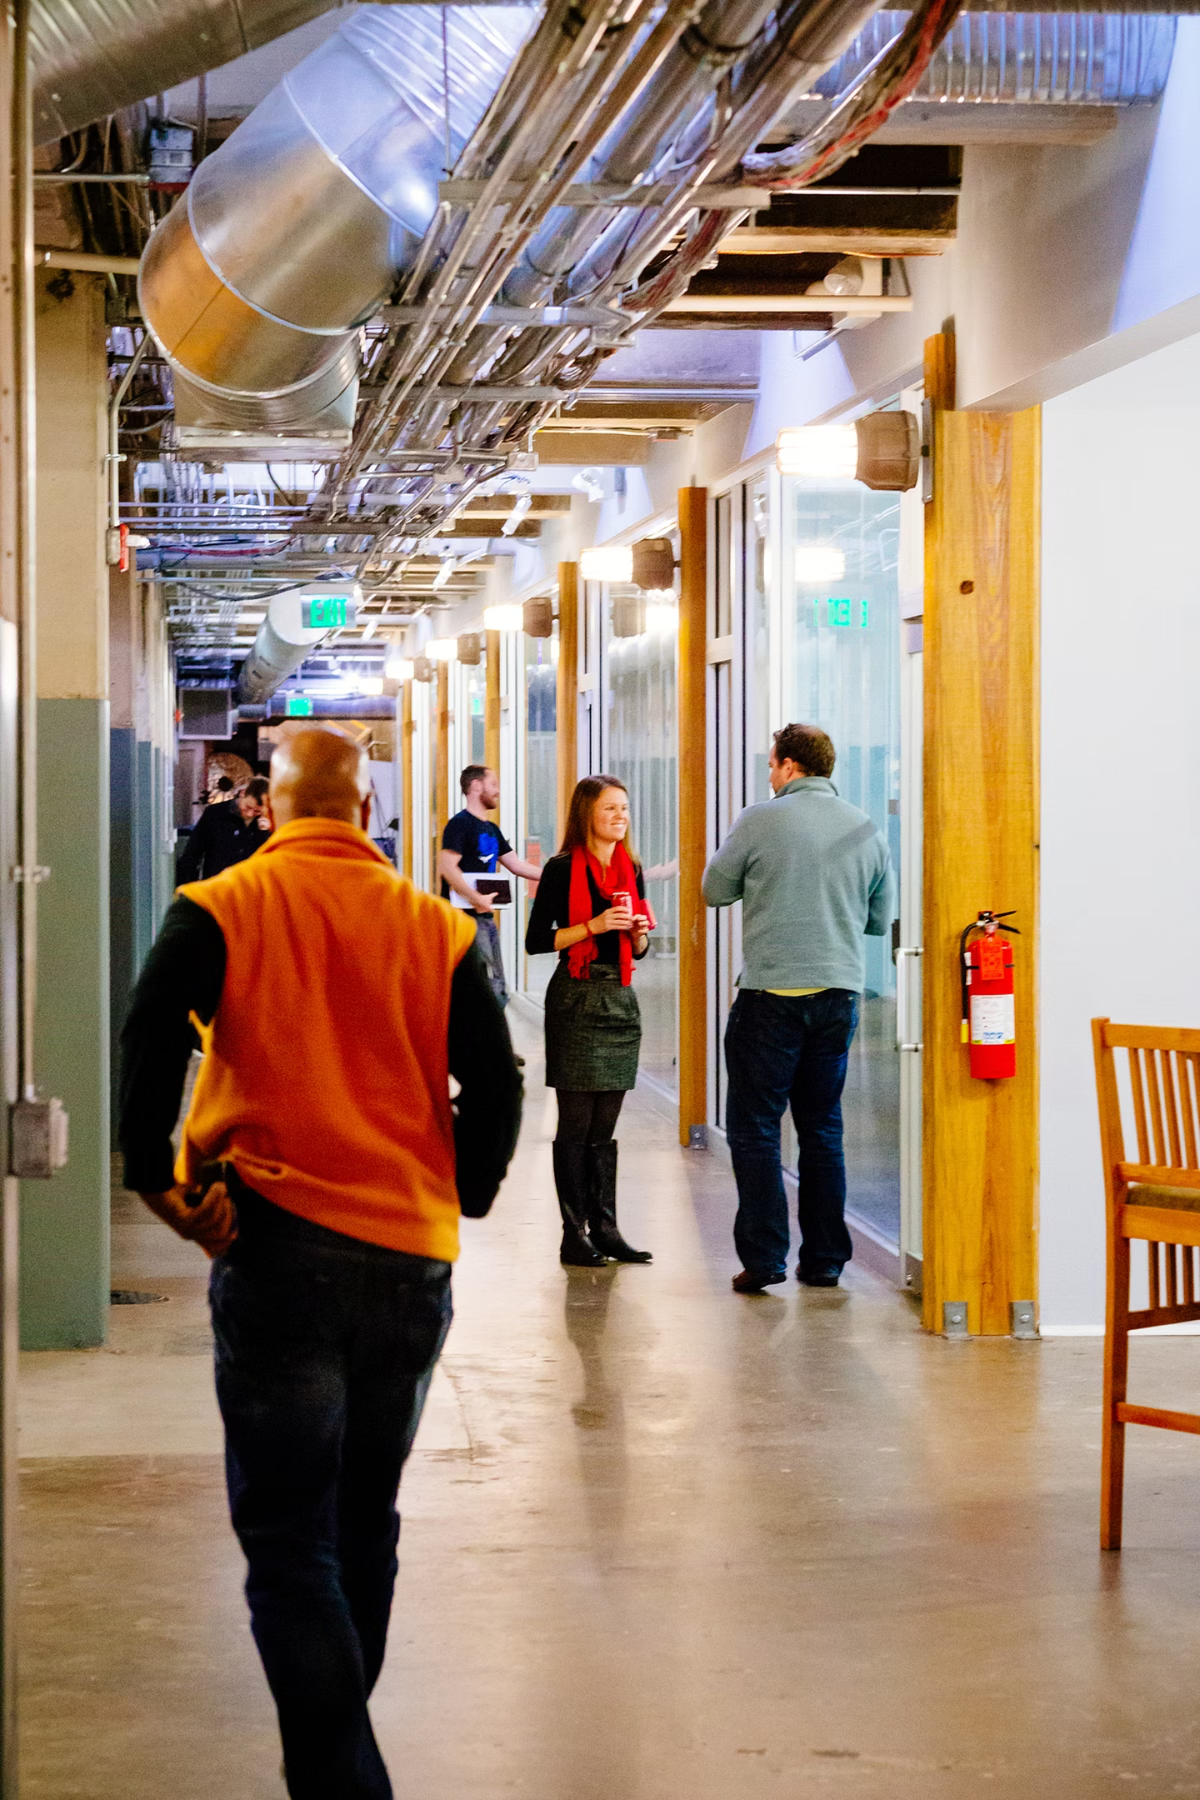
Founders are choosing proximity
Connection, not isolation. Convening, not commuting to the cloud.

Slide 4
AI scales information.
Not trust.

Slide 5





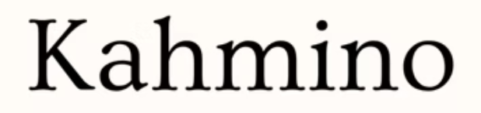




Triangle Innovation Hub

Slide 6
Community isn't where you happen to be.
It's how you win.

Slide 7



Infrastructure Looks Like This
Lunch
One Question
An Introduction
→ Partnership
→ 6 months saved
→ Everything changes
These moments don't happen on Slack. They happen in rooms like this one.

Slide 8
Founders: build community like infrastructure.
Investors: bet on ecosystems, not just companies.
Builders: own the infrastructure. Stop running events.

Slide 9

Better community beats better AI.
Let's build together.
dguvetis@americanunderground.com

