Slide 1


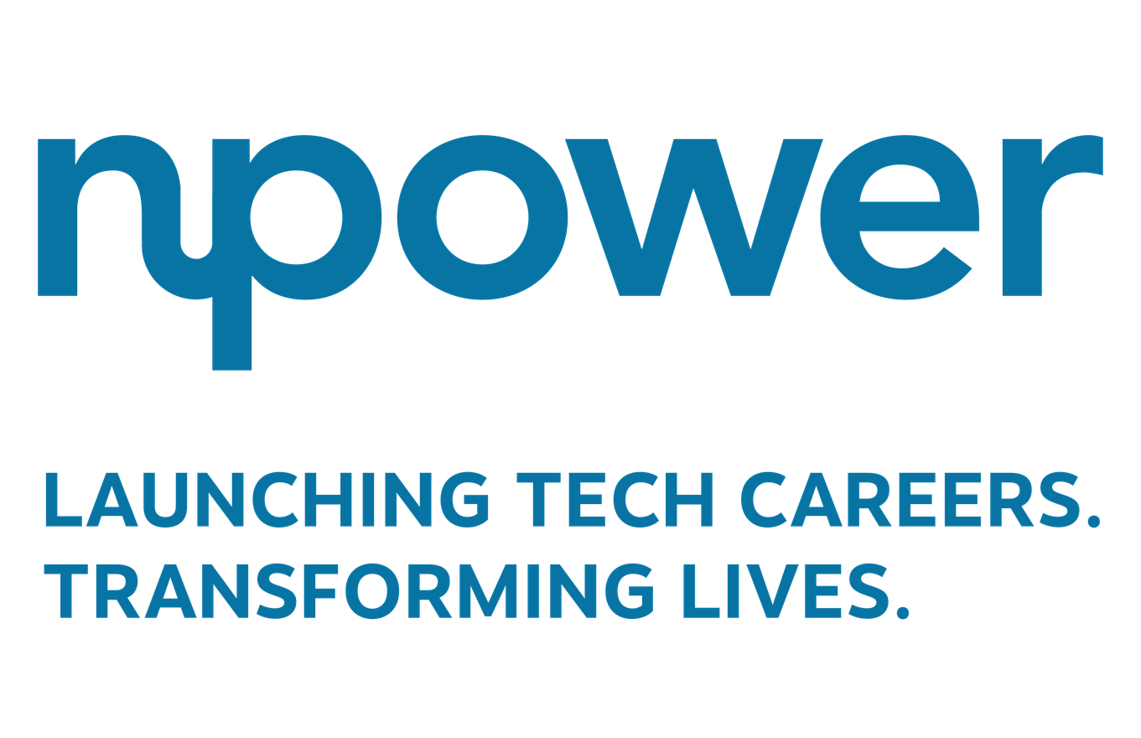


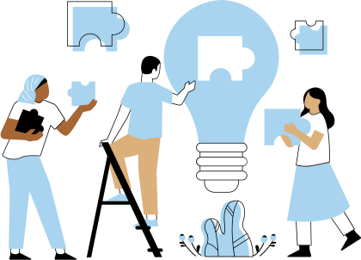


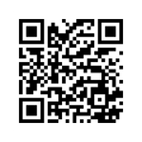
DEEP THOUGHTS
As AI continues to transform the future of work,
I believe the most important question we can ask is: Who gets to participate in that future?
Sarah Chick, MS
Site Director,
NPower North Carolina

Slide 2
DEEP THOUGHTS
The future of AI isn’t just built in labs—it’s built in communities.
Equity in AI isn’t about access to tools—it’s about access to pathways.
Preparing people—not just pipelines—is how we future‑proof the AI workforce.

