Slide 1

ALL THINGS AI 2026
AI Champions
Why the best AI strategy starts with the people closest to the work.
Boz Vitanova · Founder & CEO, TeamLift

Slide 2
The companies winning with AI
aren't the ones with the best tools.
They're the ones with the best
people using them.

Slide 3
EVERY DEPLOYMENT BEFORE THIS ONE
Every software deployment before this one had a ‘manual.’
When your company rolled out Salesforce, there was a process. Fields to fill. Stages to follow. There was a ‘best way to do it.’
Define
→
Configure
→
Train
→
Deploy

Slide 4
With AI, the output of the tool
depends entirely on the person using it.

Slide 5
A close metaphor for an AI Champions is a Six Sigma Black Belt.

Slide 6
AI Champion
Non-technical · Internal · High-performing
WHAT THEY DO
WHAT MAKES THEM QUALIFIED
WHAT THEY ARE NOT
Build AI workflows on real problems, in their actual tools, with their own data.
Create automations their teammates adopt.
Spot opportunities an outside consultant never would.
They can break a task into steps.
They can anticipate edge cases (what could go wrong, what falls outside the rules).
They can describe what 'good output' looks like for their work.
A developer.
A data scientist.
An AI enthusiast with a side project.

Slide 7
FOR THE LEADERS IN THE ROOM
What does an AI-ready leader look like?
01
02
03
Uses AI themselves to save time
Knows what is worth building
Can evaluate vendors
Starts with their own work. Drafts, summaries, research. Builds real intuition by doing, not by watching.
Can look at their team's work and spot which tasks are worth automating and which ones need human judgment.
Tells hype from reality. Knows what questions to ask before buying a tool, commissioning a project, or approving a budget.

Slide 8
THE IDEAL SCENARIO
Champions know where the problems are.
Leaders know which ones can scale.
The Champion
The Leader
Knows which problems move the business. Sets direction, removes blockers, and decides what scales.
Starts grassroots AI builds that save time and show up in metrics their company already track.
+
When these two people work together, AI stops being a technology initiative and starts being a capability that compounds.

Slide 9
FINDING YOUR FIRST WORKFLOW
The intern test.
If a smart intern joined your team tomorrow, what would their first task be?
01
02
03
Time-consuming
High likelihood to succeed
Easy to verify
It takes hours you would rather spend on work that actually needs your judgment.
The task is clear enough that a capable person can figure it out and do it well.
You can check the output quickly. Mistakes are easy to spot before anything goes wrong.

Slide 10
GOOD STARTING POINTS
Workflows that pass the intern test.
Meeting action item tracker
Daily email digest
Meeting ends. Action items captured automatically. Checks what's been done by next meeting and flags what's outstanding.
AI reads your inbox and surfaces the 5 things that need your attention. Every morning.
SOP builder from meeting notes
Report-to-email translator
Record a process walkthrough. Get a formatted standard operating procedure ready to share.
Paste a data report. Get a plain-English email ready to send to your team or leadership.
Sales proposal generator
Compliance monitor
Paste your call notes and company context. Get a first draft proposal ready to refine and send.
Tracks regulatory updates, new rulings, and policy changes relevant to your industry. Delivers a weekly digest so you stay current without manually scanning sources.

Slide 11




HOW IT WORKS
→
→
→
LLM
Connector
Champion
First win
Thinks and generates
Moves data between tools
Figures out what to build
Creates momentum
Drafts, summarizes, analyzes. Give it context, get an output. Copilot. ChatGPT, Claude, Gemini.
Make.com, Zapier, n8n. Watches for a trigger, runs a sequence, no manual copy-paste.
Knows the work from the inside. Spots the workflow worth automating. Designs the logic.
One working workflow. Saves real time. Teammates notice. The pull starts.

Slide 12
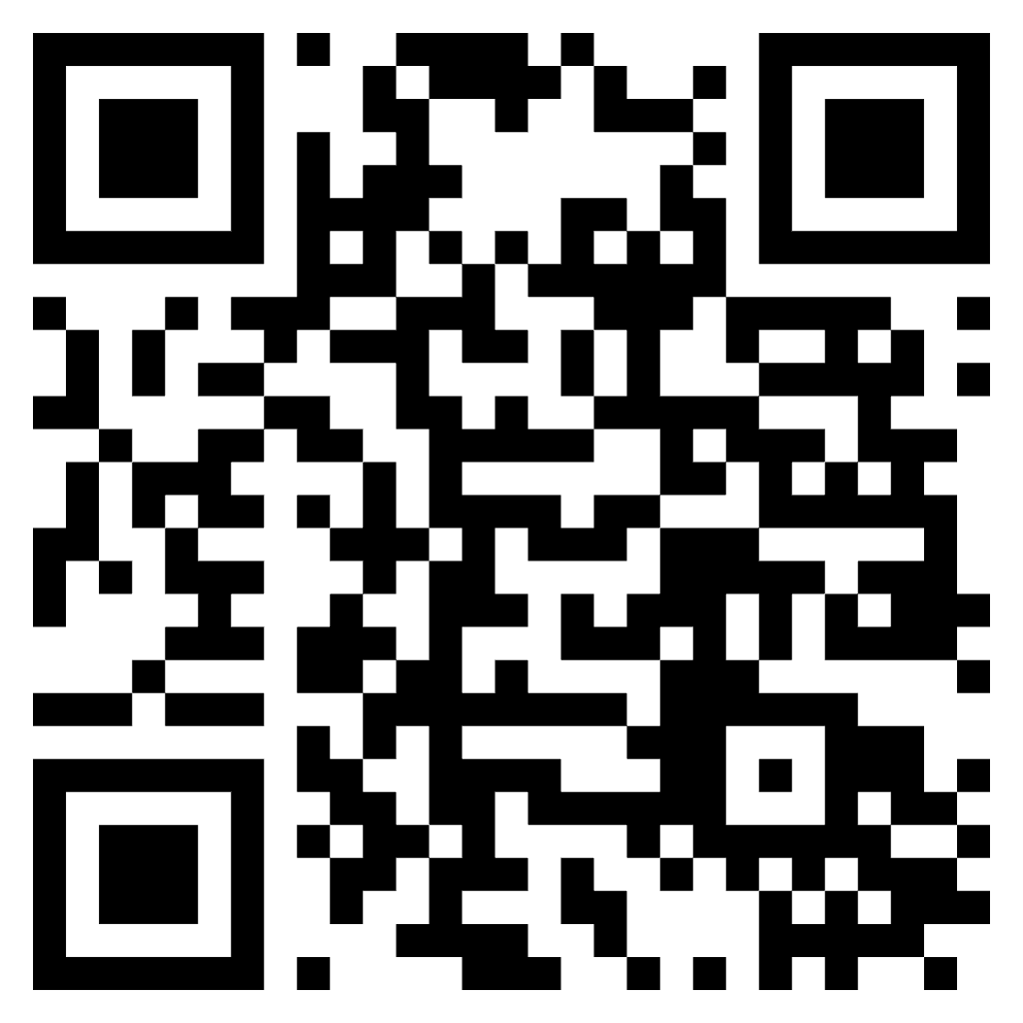
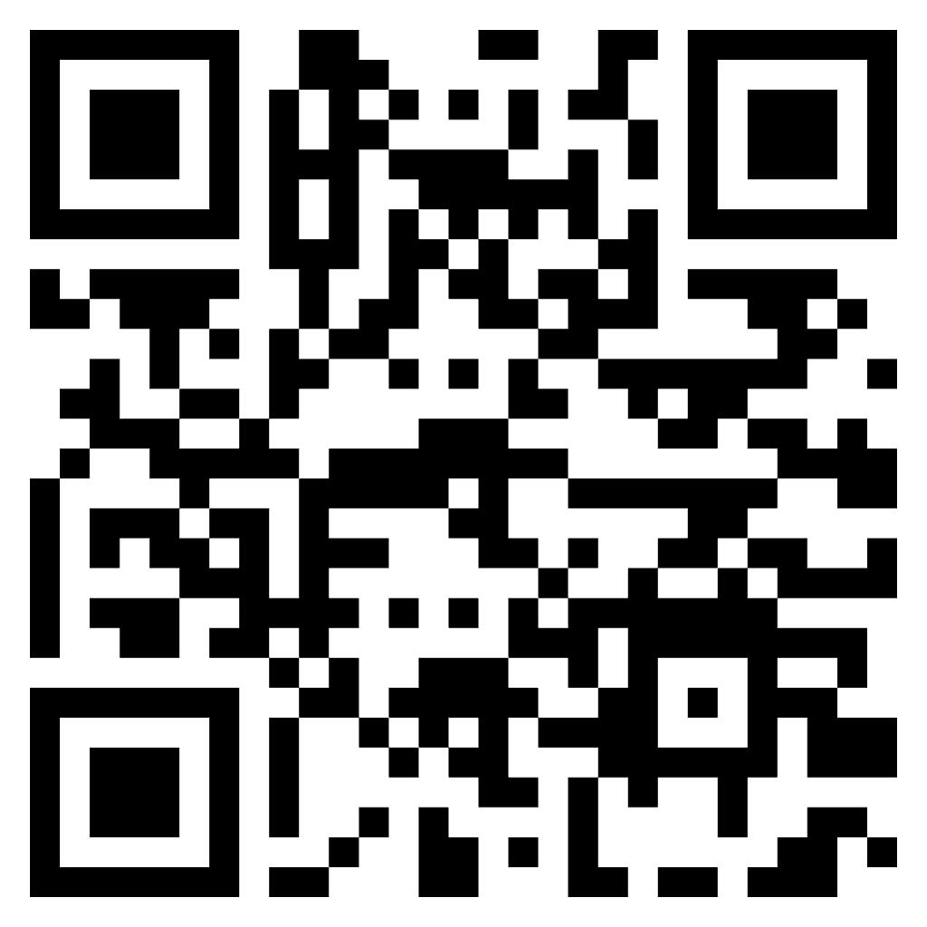
Identify your first win
We turn your talent into AI Champions through 1:1 training.
We help you identify the right people for each team.
Connect on LinkedIn
We train them 1:1 on their real work.
We help them build AI workflows the team uses.
We equip leaders to scale what gets built.
Boz Vitanova · Founder & CEO, TeamLift

